Slide 1
CCTV PRODUCT CATALOG
安防监控摄像头产品目录
SOLAR · INDOOR WiFi · OUTDOOR WiFi / 4G · BULB
太阳能 · 长电室内 WiFi · 长电室外 WiFi / 4G · 灯泡机
深圳市东鸿视科技有限公司
Shenzhen Donghongshi Technology Co., Ltd.
2026
Lily | +86 13715157004
Notes:
[Sources]
- User-provided spreadsheets: 4b36545e-6f24-489e-8d24-674fc9f40ce4.xlsx; 345867b3-671b-4939-bcb6-75932a0da9e4.xlsx; 2dbdb94d-9a93-4384-b962-278c52598bff.xlsx

Slide 2
Product Series / 产品系列
DS-S01—
Solar & Low-Power Cameras / 太阳能与低功耗摄像机
34 styles / 34 款
Off-grid monitoring with solar charging and low-power operation / 面向离网监控的太阳能充电与低功耗方案
DS-L01—
Powered WiFi Indoor Cameras / 长电 WiFi 室内摄像机
30 styles / 30 款
Continuous-power indoor monitoring and video-call solutions / 持续供电的室内监控与视频通话方案
DS-P01—
Powered WiFi & 4G Outdoor Cameras / 长电 WiFi 与 4G 室外摄像机
87 styles / 87 款
Professional outdoor PTZ, multi-lens and 4G surveillance / 专业室外云台、多镜头与 4G 监控方案
DS-B01—
Bulb Cameras / 灯泡摄像机
8 styles / 8 款
Easy-install E27 lighting and surveillance solutions / 易安装的 E27 照明监控方案
深圳市东鸿视科技有限公司 | Shenzhen Donghongshi Technology Co., Ltd.
Lily | +86 13715157004 | 2
Notes:
[Sources]
- Series mapping and product counts derived from the three user-provided spreadsheets.

Slide 3
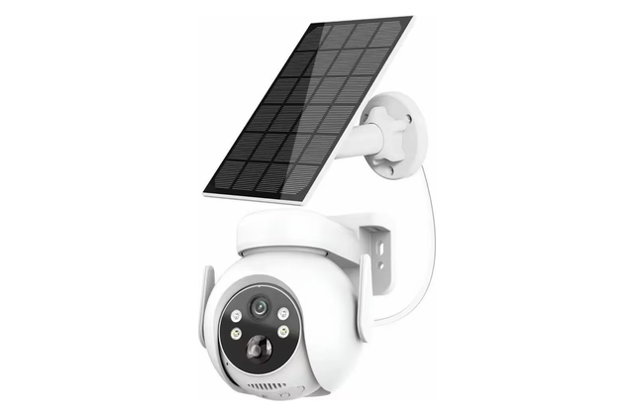
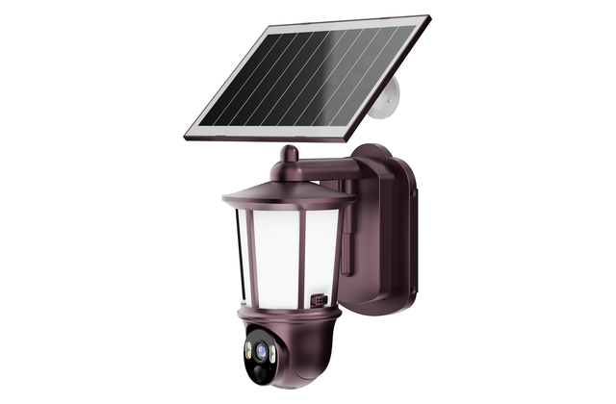
Solar Cameras / 太阳能摄像机
01 / 17
DS-S01
Pixel / 像素: 3MP | APP: Carecam Pro
• Solar-powered installation / 太阳能供电安装
• WiFi remote viewing / WiFi 远程查看
• Two-way audio intercom / 双向语音对讲
• Outdoor installation design / 适合室外安装
• TF card and cloud storage / TF卡与云存储
1 / 34
DS-S02
Pixel / 像素: 3MP | APP: Carecam Pro
• Solar-powered installation / 太阳能供电安装
• AOV low-power monitoring / AOV 低功耗监控
• WiFi remote viewing / WiFi 远程查看
• AI human detection & tracking / AI 人形侦测与追踪
• Two-way audio intercom / 双向语音对讲
2 / 34
深圳市东鸿视科技有限公司 | Shenzhen Donghongshi Technology Co., Ltd.
Lily | +86 13715157004 | 3
Notes:
[Sources]
- Workbook 1, 牵心Pro（Carecampro), row 37
- Workbook 1, 牵心Pro（Carecampro), row 38

Slide 4
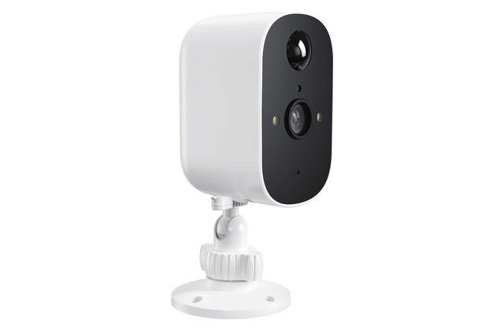
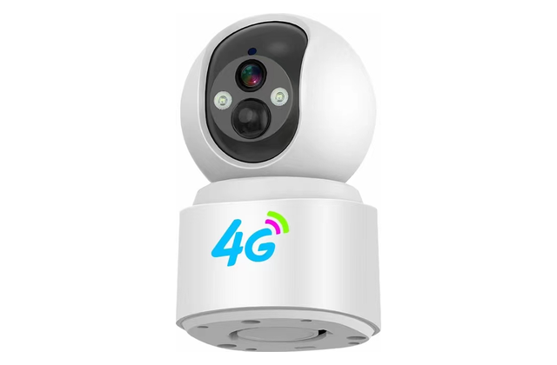
Solar Cameras / 太阳能摄像机
02 / 17
DS-S03
Pixel / 像素: 3MP | APP: Carecam Pro
• Solar-powered installation / 太阳能供电安装
• WiFi remote viewing / WiFi 远程查看
• Two-way audio intercom / 双向语音对讲
• Infrared night vision / 红外夜视
• Outdoor installation design / 适合室外安装
3 / 34
DS-S04
Pixel / 像素: 3MP+3MP | APP: V380 Pro
• 4G LTE and WiFi options / 支持 4G LTE 与 WiFi 版本
• Dual-lens dual-view monitoring / 双镜头双画面监控
• 355° pan & 100° tilt / 355° 水平与 100° 垂直云台
• Smart motion and human detection / 智能移动与人形侦测
4 / 34
深圳市东鸿视科技有限公司 | Shenzhen Donghongshi Technology Co., Ltd.
Lily | +86 13715157004 | 4
Notes:
[Sources]
- Workbook 1, 牵心Pro（Carecampro), row 39
- Workbook 2, 低功耗, row 5
- Workbook 2, 低功耗, row 6

Slide 5
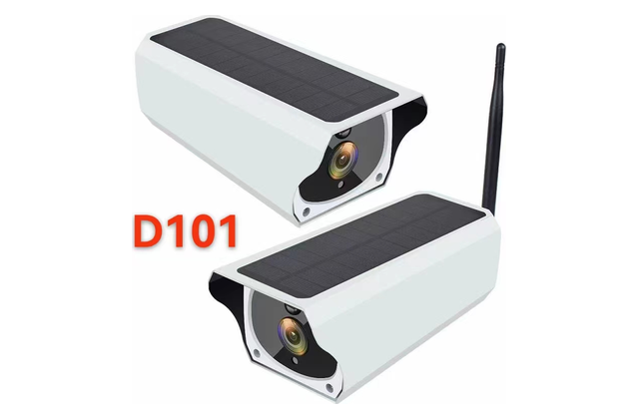
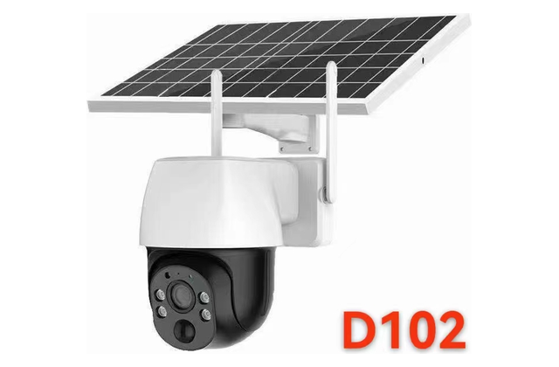
Solar Cameras / 太阳能摄像机
03 / 17
DS-S05
Pixel / 像素: 3MP | APP: V380 Pro
• 5W solar charging / 5W 太阳能充电
• 6000mAh rechargeable battery / 6000mAh 可充电电池
• 4G LTE and WiFi options / 支持 4G LTE 与 WiFi 版本
• 355° pan & 100° tilt / 355° 水平与 100° 垂直云台
• Smart motion and human detection / 智能移动与人形侦测
5 / 34
DS-S06
Pixel / 像素: 3MP | APP: V380 Pro
• 7W solar charging / 7W 太阳能充电
• 10000mAh rechargeable battery / 10000mAh 可充电电池
• 4G LTE and WiFi options / 支持 4G LTE 与 WiFi 版本
• 355° pan & 100° tilt / 355° 水平与 100° 垂直云台
• Smart motion and human detection / 智能移动与人形侦测
6 / 34
深圳市东鸿视科技有限公司 | Shenzhen Donghongshi Technology Co., Ltd.
Lily | +86 13715157004 | 5
Notes:
[Sources]
- Workbook 2, 低功耗, row 7
- Workbook 2, 低功耗, row 8
- Workbook 2, 低功耗, row 9
- Workbook 2, 低功耗, row 10

Slide 6
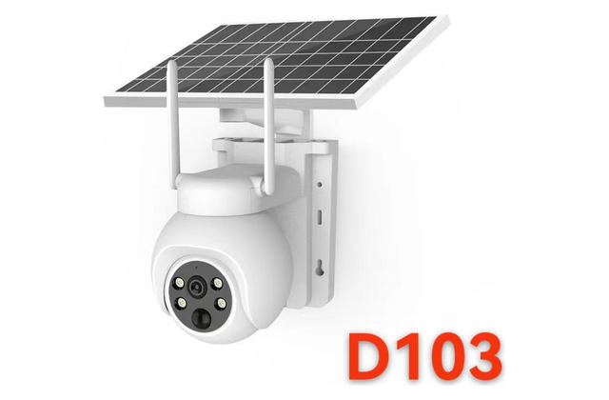
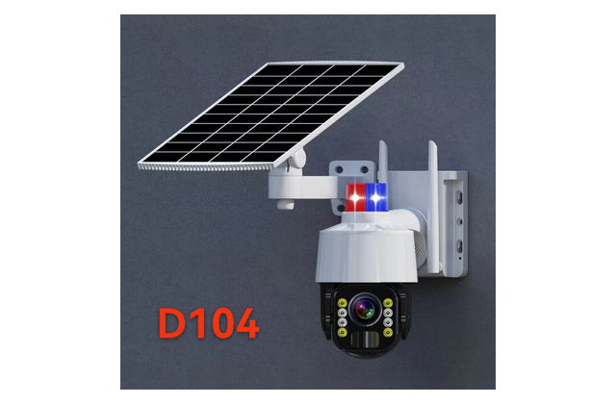
Solar Cameras / 太阳能摄像机
04 / 17
DS-S07
Pixel / 像素: 3MP | APP: V380 Pro
• 7W solar charging / 7W 太阳能充电
• 10000mAh rechargeable battery / 10000mAh 可充电电池
• 4G LTE and WiFi options / 支持 4G LTE 与 WiFi 版本
• 355° pan & 100° tilt / 355° 水平与 100° 垂直云台
• Smart motion and human detection / 智能移动与人形侦测
7 / 34
DS-S08
Pixel / 像素: 3MP | APP: V380 Pro
• 7W solar charging / 7W 太阳能充电
• 10000mAh rechargeable battery / 10000mAh 可充电电池
• 4G LTE and WiFi options / 支持 4G LTE 与 WiFi 版本
• 355° pan & 100° tilt / 355° 水平与 100° 垂直云台
• Smart motion and human detection / 智能移动与人形侦测
8 / 34
深圳市东鸿视科技有限公司 | Shenzhen Donghongshi Technology Co., Ltd.
Lily | +86 13715157004 | 6
Notes:
[Sources]
- Workbook 2, 低功耗, row 11
- Workbook 2, 低功耗, row 12
- Workbook 2, 低功耗, row 13
- Workbook 2, 低功耗, row 14

Slide 7
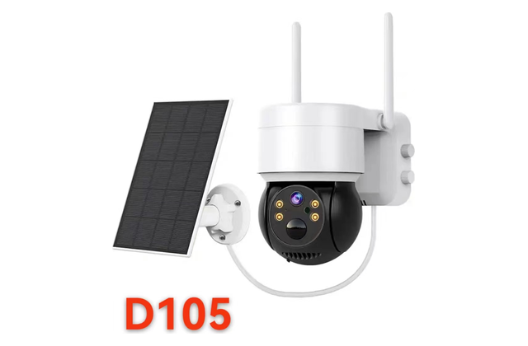
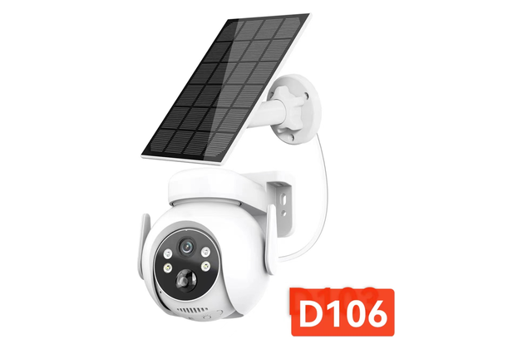
Solar Cameras / 太阳能摄像机
05 / 17
DS-S09
Pixel / 像素: 3MP | APP: V380 Pro
• 7W solar charging / 7W 太阳能充电
• 10000mAh rechargeable battery / 10000mAh 可充电电池
• 4G LTE and WiFi options / 支持 4G LTE 与 WiFi 版本
• 355° pan & 100° tilt / 355° 水平与 100° 垂直云台
• Smart motion and human detection / 智能移动与人形侦测
9 / 34
DS-S10
Pixel / 像素: 3MP | APP: V380 Pro
• 7W solar charging / 7W 太阳能充电
• 10000mAh rechargeable battery / 10000mAh 可充电电池
• 4G LTE and WiFi options / 支持 4G LTE 与 WiFi 版本
• 355° pan & 100° tilt / 355° 水平与 100° 垂直云台
• Smart motion and human detection / 智能移动与人形侦测
10 / 34
深圳市东鸿视科技有限公司 | Shenzhen Donghongshi Technology Co., Ltd.
Lily | +86 13715157004 | 7
Notes:
[Sources]
- Workbook 2, 低功耗, row 15
- Workbook 2, 低功耗, row 16
- Workbook 2, 低功耗, row 17
- Workbook 2, 低功耗, row 18

Slide 8
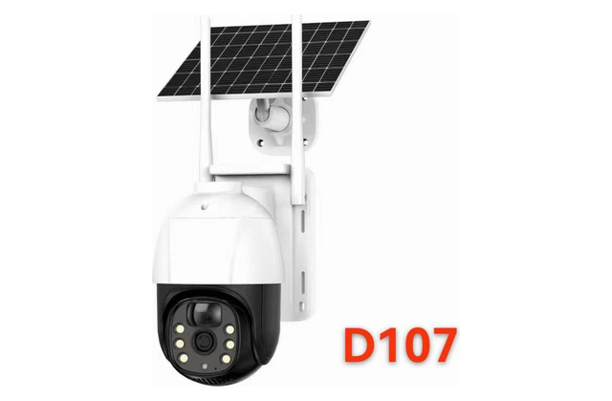
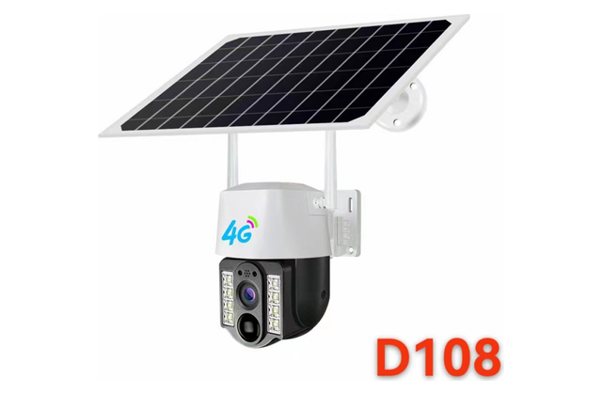
Solar Cameras / 太阳能摄像机
06 / 17
DS-S11
Pixel / 像素: 3MP | APP: V380 Pro
• 7W solar charging / 7W 太阳能充电
• 10000mAh rechargeable battery / 10000mAh 可充电电池
• 4G LTE and WiFi options / 支持 4G LTE 与 WiFi 版本
• 355° pan & 100° tilt / 355° 水平与 100° 垂直云台
• Smart motion and human detection / 智能移动与人形侦测
11 / 34
DS-S12
Pixel / 像素: 3MP | APP: V380 Pro
• 7W solar charging / 7W 太阳能充电
• 10000mAh rechargeable battery / 10000mAh 可充电电池
• 4G LTE and WiFi options / 支持 4G LTE 与 WiFi 版本
• 355° pan & 100° tilt / 355° 水平与 100° 垂直云台
• Smart motion and human detection / 智能移动与人形侦测
12 / 34
深圳市东鸿视科技有限公司 | Shenzhen Donghongshi Technology Co., Ltd.
Lily | +86 13715157004 | 8
Notes:
[Sources]
- Workbook 2, 低功耗, row 19
- Workbook 2, 低功耗, row 20
- Workbook 2, 低功耗, row 21
- Workbook 2, 低功耗, row 22

Slide 9
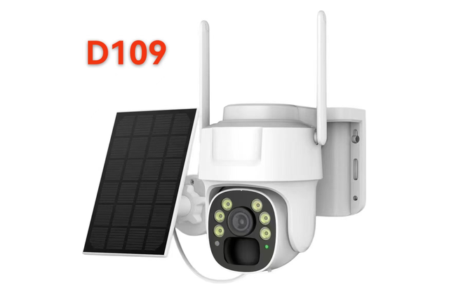
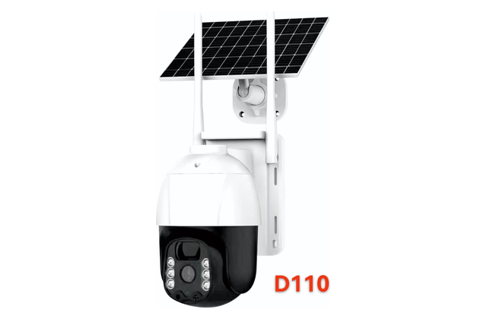
Solar Cameras / 太阳能摄像机
07 / 17
DS-S13
Original model / 原型号: D109-4G / D109-WIFI
Pixel / 像素: 3MP | APP: V380 Pro
• 7W solar charging / 7W 太阳能充电
• 10000mAh rechargeable battery / 10000mAh 可充电电池
• 4G LTE and WiFi options / 支持 4G LTE 与 WiFi 版本
• 355° pan & 100° tilt / 355° 水平与 100° 垂直云台
• Smart motion and human detection / 智能移动与人形侦测
13 / 34
DS-S14
Original model / 原型号: D110-4G / D110-WIFI
Pixel / 像素: 3MP | APP: V380 Pro
• 7W solar charging / 7W 太阳能充电
• 10000mAh rechargeable battery / 10000mAh 可充电电池
• 4G LTE and WiFi options / 支持 4G LTE 与 WiFi 版本
• 355° pan & 100° tilt / 355° 水平与 100° 垂直云台
• Smart motion and human detection / 智能移动与人形侦测
14 / 34
深圳市东鸿视科技有限公司 | Shenzhen Donghongshi Technology Co., Ltd.
Lily | +86 13715157004 | 9
Notes:
[Sources]
- Workbook 2, 低功耗, row 23
- Workbook 2, 低功耗, row 24
- Workbook 2, 低功耗, row 25
- Workbook 2, 低功耗, row 26

Slide 10
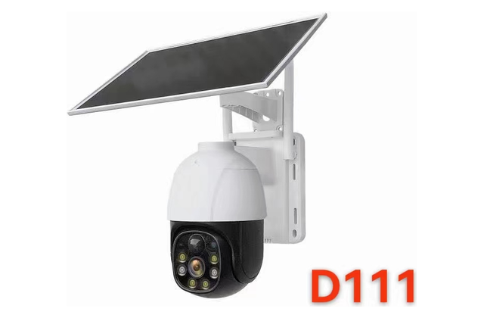
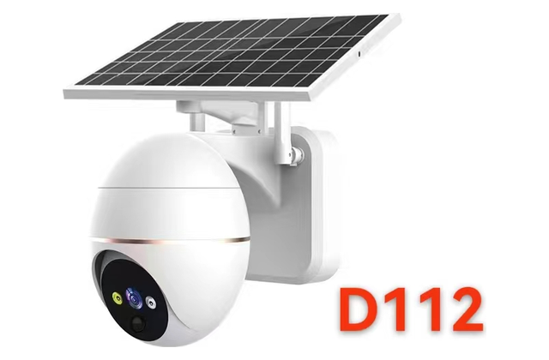
Solar Cameras / 太阳能摄像机
08 / 17
DS-S15
Pixel / 像素: 3MP | APP: V380 Pro
• 7W solar charging / 7W 太阳能充电
• 10000mAh rechargeable battery / 10000mAh 可充电电池
• 4G LTE and WiFi options / 支持 4G LTE 与 WiFi 版本
• 355° pan & 100° tilt / 355° 水平与 100° 垂直云台
• Smart motion and human detection / 智能移动与人形侦测
15 / 34
DS-S16
Pixel / 像素: 3MP | APP: V380 Pro
• 7W solar charging / 7W 太阳能充电
• 10000mAh rechargeable battery / 10000mAh 可充电电池
• 4G LTE and WiFi options / 支持 4G LTE 与 WiFi 版本
• 355° pan & 100° tilt / 355° 水平与 100° 垂直云台
• Smart motion and human detection / 智能移动与人形侦测
16 / 34
深圳市东鸿视科技有限公司 | Shenzhen Donghongshi Technology Co., Ltd.
Lily | +86 13715157004 | 10
Notes:
[Sources]
- Workbook 2, 低功耗, row 27
- Workbook 2, 低功耗, row 28
- Workbook 2, 低功耗, row 29
- Workbook 2, 低功耗, row 30

Slide 11
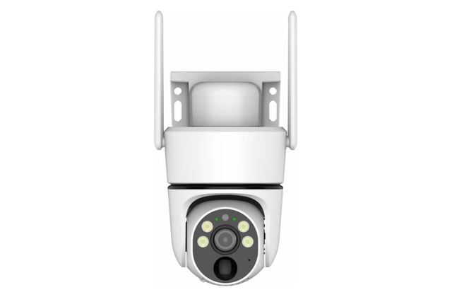
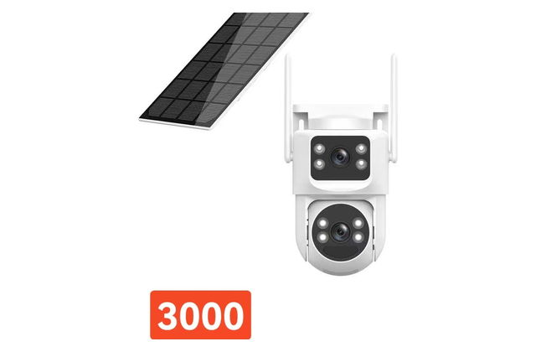
Solar Cameras / 太阳能摄像机
09 / 17
DS-S17
Pixel / 像素: 3MP | APP: V380 Pro
• 7W solar charging / 7W 太阳能充电
• 10000mAh rechargeable battery / 10000mAh 可充电电池
• 4G LTE and WiFi options / 支持 4G LTE 与 WiFi 版本
• 355° pan & 100° tilt / 355° 水平与 100° 垂直云台
• Smart motion and human detection / 智能移动与人形侦测
17 / 34
DS-S18
Pixel / 像素: 3MP+3MP | APP: V380 Pro
• 7W solar charging / 7W 太阳能充电
• 10000mAh rechargeable battery / 10000mAh 可充电电池
• 4G LTE and WiFi options / 支持 4G LTE 与 WiFi 版本
• Dual-lens dual-view monitoring / 双镜头双画面监控
• 355° pan & 100° tilt / 355° 水平与 100° 垂直云台
18 / 34
深圳市东鸿视科技有限公司 | Shenzhen Donghongshi Technology Co., Ltd.
Lily | +86 13715157004 | 11
Notes:
[Sources]
- Workbook 2, 低功耗, row 31
- Workbook 2, 低功耗, row 32
- Workbook 2, 低功耗, row 33
- Workbook 2, 低功耗, row 34

Slide 12
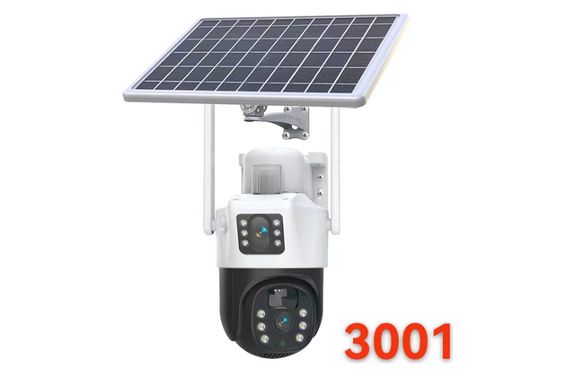
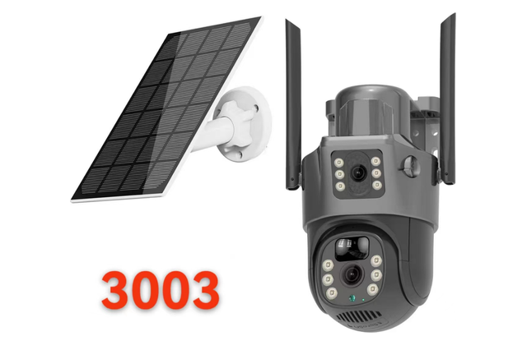
Solar Cameras / 太阳能摄像机
10 / 17
DS-S19
Pixel / 像素: 3MP+3MP | APP: V380 Pro
• 7W solar charging / 7W 太阳能充电
• 10000mAh rechargeable battery / 10000mAh 可充电电池
• 4G LTE and WiFi options / 支持 4G LTE 与 WiFi 版本
• Dual-lens dual-view monitoring / 双镜头双画面监控
• 355° pan & 100° tilt / 355° 水平与 100° 垂直云台
19 / 34
DS-S20
Pixel / 像素: 3MP+3MP | APP: V380 Pro
• 7W solar charging / 7W 太阳能充电
• 10000mAh rechargeable battery / 10000mAh 可充电电池
• 4G LTE and WiFi options / 支持 4G LTE 与 WiFi 版本
• Dual-lens dual-view monitoring / 双镜头双画面监控
• 355° pan & 100° tilt / 355° 水平与 100° 垂直云台
20 / 34
深圳市东鸿视科技有限公司 | Shenzhen Donghongshi Technology Co., Ltd.
Lily | +86 13715157004 | 12
Notes:
[Sources]
- Workbook 2, 低功耗, row 35
- Workbook 2, 低功耗, row 36
- Workbook 2, 低功耗, row 37
- Workbook 2, 低功耗, row 38

Slide 13
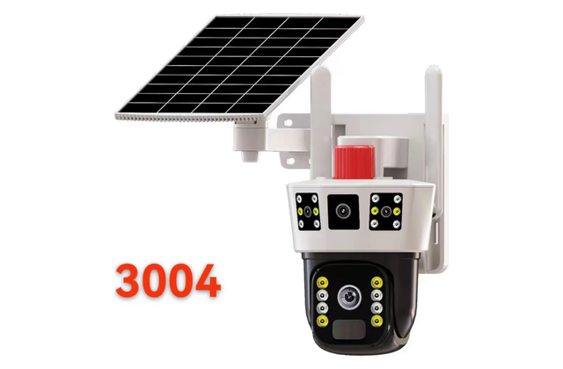
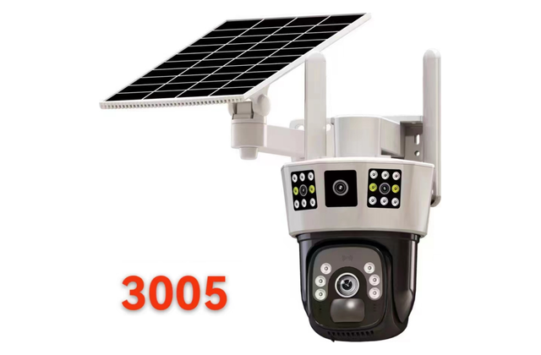
Solar Cameras / 太阳能摄像机
11 / 17
DS-S21
Pixel / 像素: 3MP+3MP | APP: V380 Pro
• 7W solar charging / 7W 太阳能充电
• 10000mAh rechargeable battery / 10000mAh 可充电电池
• 4G LTE and WiFi options / 支持 4G LTE 与 WiFi 版本
• Dual-lens dual-view monitoring / 双镜头双画面监控
• 355° pan & 100° tilt / 355° 水平与 100° 垂直云台
21 / 34
DS-S22
Pixel / 像素: 3MP+3MP | APP: V380 Pro
• 7W solar charging / 7W 太阳能充电
• 10000mAh rechargeable battery / 10000mAh 可充电电池
• 4G LTE and WiFi options / 支持 4G LTE 与 WiFi 版本
• Dual-lens dual-view monitoring / 双镜头双画面监控
• 355° pan & 100° tilt / 355° 水平与 100° 垂直云台
22 / 34
深圳市东鸿视科技有限公司 | Shenzhen Donghongshi Technology Co., Ltd.
Lily | +86 13715157004 | 13
Notes:
[Sources]
- Workbook 2, 低功耗, row 39
- Workbook 2, 低功耗, row 40
- Workbook 2, 低功耗, row 41
- Workbook 2, 低功耗, row 42

Slide 14
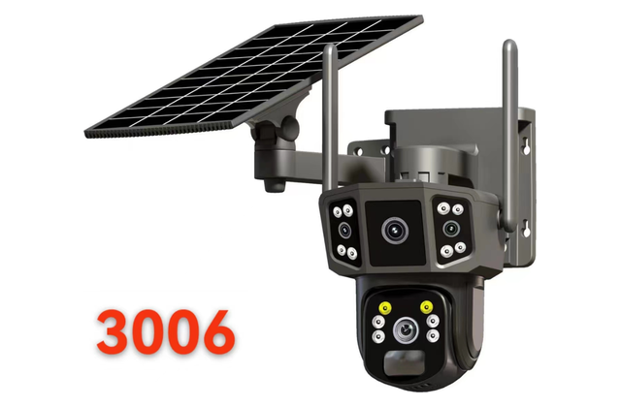
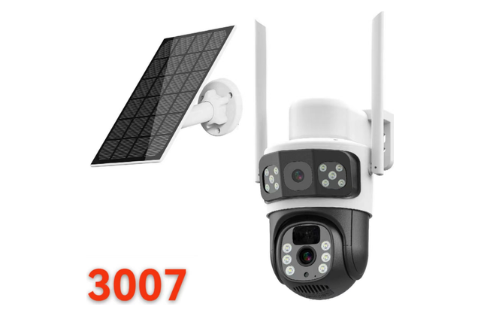
Solar Cameras / 太阳能摄像机
12 / 17
DS-S23
Pixel / 像素: 3MP | APP: V380 Pro
• 7W solar charging / 7W 太阳能充电
• 10000mAh rechargeable battery / 10000mAh 可充电电池
• 4G LTE and WiFi options / 支持 4G LTE 与 WiFi 版本
• Dual-lens dual-view monitoring / 双镜头双画面监控
• 355° pan & 100° tilt / 355° 水平与 100° 垂直云台
23 / 34
DS-S24
Pixel / 像素: 3MP | APP: V380 Pro
• 7W solar charging / 7W 太阳能充电
• 10000mAh rechargeable battery / 10000mAh 可充电电池
• 4G LTE and WiFi options / 支持 4G LTE 与 WiFi 版本
• Dual-lens dual-view monitoring / 双镜头双画面监控
• 355° pan & 100° tilt / 355° 水平与 100° 垂直云台
24 / 34
深圳市东鸿视科技有限公司 | Shenzhen Donghongshi Technology Co., Ltd.
Lily | +86 13715157004 | 14
Notes:
[Sources]
- Workbook 2, 低功耗, row 43
- Workbook 2, 低功耗, row 44
- Workbook 2, 低功耗, row 45
- Workbook 2, 低功耗, row 46

Slide 15
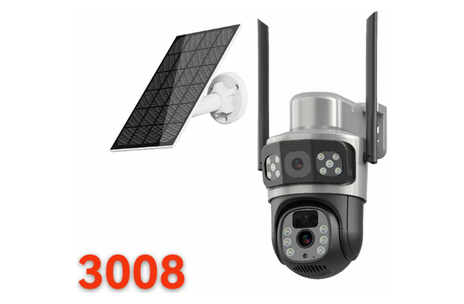
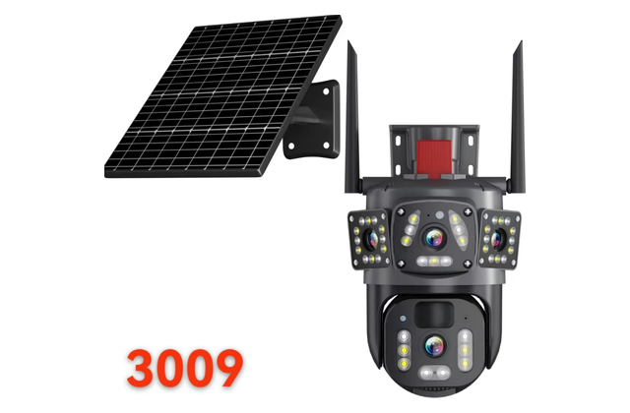
Solar Cameras / 太阳能摄像机
13 / 17
DS-S25
Pixel / 像素: 3MP | APP: V380 Pro
• 7W solar charging / 7W 太阳能充电
• 10000mAh rechargeable battery / 10000mAh 可充电电池
• 4G LTE and WiFi options / 支持 4G LTE 与 WiFi 版本
• Dual-lens dual-view monitoring / 双镜头双画面监控
• 355° pan & 100° tilt / 355° 水平与 100° 垂直云台
25 / 34
DS-S26
Pixel / 像素: 3MP | APP: V380 Pro
• 7W solar charging / 7W 太阳能充电
• 10000mAh rechargeable battery / 10000mAh 可充电电池
• 4G LTE and WiFi options / 支持 4G LTE 与 WiFi 版本
• Dual-lens dual-view monitoring / 双镜头双画面监控
• 355° pan & 100° tilt / 355° 水平与 100° 垂直云台
26 / 34
深圳市东鸿视科技有限公司 | Shenzhen Donghongshi Technology Co., Ltd.
Lily | +86 13715157004 | 15
Notes:
[Sources]
- Workbook 2, 低功耗, row 47
- Workbook 2, 低功耗, row 48
- Workbook 2, 低功耗, row 49
- Workbook 2, 低功耗, row 50
- Workbook 2, 低功耗, row 60

Slide 16
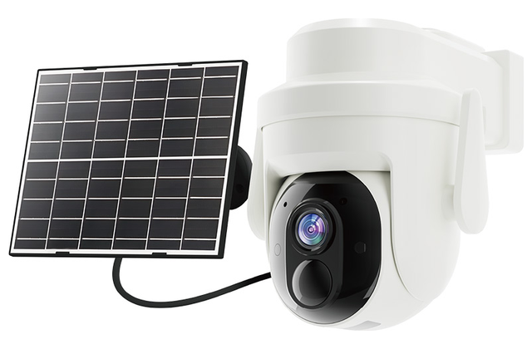
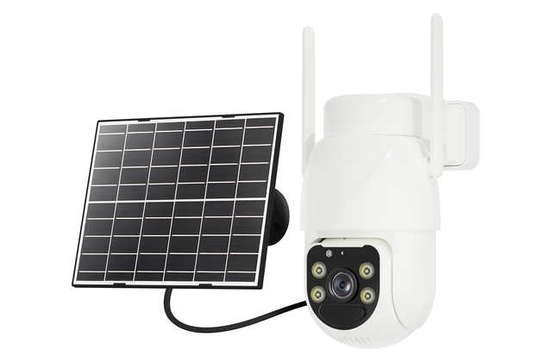
Solar Cameras / 太阳能摄像机
14 / 17
DS-S27
Pixel / 像素: 300万 | APP: Yoosee
• Solar-powered installation / 太阳能供电安装
• AOV low-power monitoring / AOV 低功耗监控
• 4G LTE SIM connectivity / 4G LTE SIM 卡联网
• Remote pan-tilt control / 远程云台控制
• AI human detection & tracking / AI 人形侦测与追踪
27 / 34
DS-S28
Pixel / 像素: 4MP | APP: Yoosee
• Solar-powered installation / 太阳能供电安装
• 4G LTE and WiFi options / 支持 4G LTE 与 WiFi 版本
• Remote pan-tilt control / 远程云台控制
• Smart motion and human detection / 智能移动与人形侦测
• Two-way audio intercom / 双向语音对讲
28 / 34
深圳市东鸿视科技有限公司 | Shenzhen Donghongshi Technology Co., Ltd.
Lily | +86 13715157004 | 16
Notes:
[Sources]
- Workbook 3, Chinese Quotation, row 17
- Workbook 3, Chinese Quotation, row 18
- Workbook 3, Chinese Quotation, row 19
- Workbook 3, Chinese Quotation, row 20

Slide 17
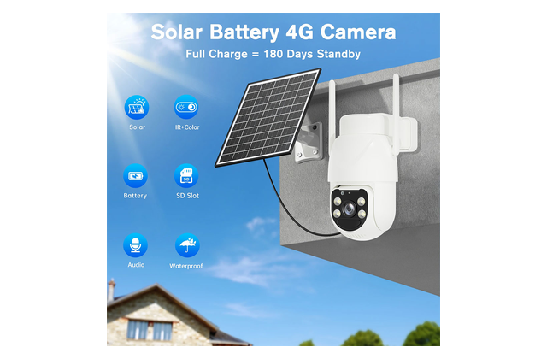
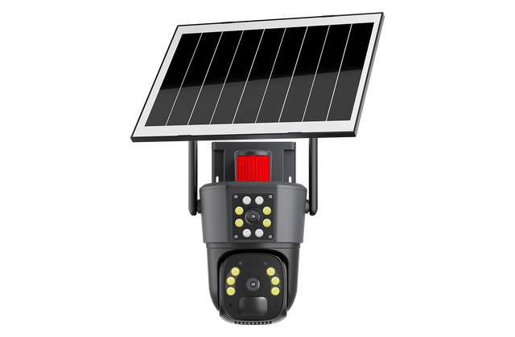
Solar Cameras / 太阳能摄像机
15 / 17
DS-S29
Pixel / 像素: 400万 | APP: Yoosee
• Solar-powered installation / 太阳能供电安装
• AOV low-power monitoring / AOV 低功耗监控
• 4G LTE SIM connectivity / 4G LTE SIM 卡联网
• Remote pan-tilt control / 远程云台控制
• AI human detection & tracking / AI 人形侦测与追踪
29 / 34
DS-S30
Pixel / 像素: 4MP | APP: Yoosee
• Solar-powered installation / 太阳能供电安装
• AOV low-power monitoring / AOV 低功耗监控
• 4G LTE SIM connectivity / 4G LTE SIM 卡联网
• AI human detection & tracking / AI 人形侦测与追踪
• Two-way audio intercom / 双向语音对讲
30 / 34
深圳市东鸿视科技有限公司 | Shenzhen Donghongshi Technology Co., Ltd.
Lily | +86 13715157004 | 17
Notes:
[Sources]
- Workbook 3, Chinese Quotation, row 21
- Workbook 3, Chinese Quotation, row 22
- Workbook 3, Chinese Quotation, row 23
- Workbook 3, Chinese Quotation, row 24
- Workbook 3, Chinese Quotation, row 25
- Workbook 3, Chinese Quotation, row 26

Slide 18
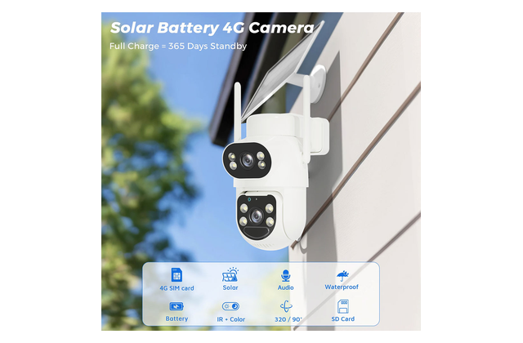
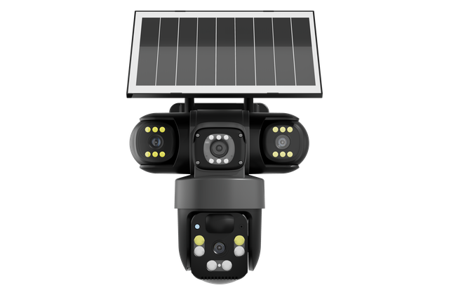
Solar Cameras / 太阳能摄像机
16 / 17
DS-S31
Pixel / 像素: 4MP | APP: Yoosee
• Solar-powered installation / 太阳能供电安装
• AOV low-power monitoring / AOV 低功耗监控
• 4G LTE SIM connectivity / 4G LTE SIM 卡联网
• Remote pan-tilt control / 远程云台控制
• AI human detection & tracking / AI 人形侦测与追踪
31 / 34
DS-S32
Pixel / 像素: 6MP（1920*1080*3） | APP: Yoosee
• Solar-powered installation / 太阳能供电安装
• AOV low-power monitoring / AOV 低功耗监控
• 4G LTE SIM connectivity / 4G LTE SIM 卡联网
• AI human detection & tracking / AI 人形侦测与追踪
• Two-way audio intercom / 双向语音对讲
32 / 34
深圳市东鸿视科技有限公司 | Shenzhen Donghongshi Technology Co., Ltd.
Lily | +86 13715157004 | 18
Notes:
[Sources]
- Workbook 3, Chinese Quotation, row 27
- Workbook 3, Chinese Quotation, row 28
- Workbook 3, Chinese Quotation, row 29
- Workbook 3, Chinese Quotation, row 30
- Workbook 3, Chinese Quotation, row 31
- Workbook 3, Chinese Quotation, row 32

Slide 19
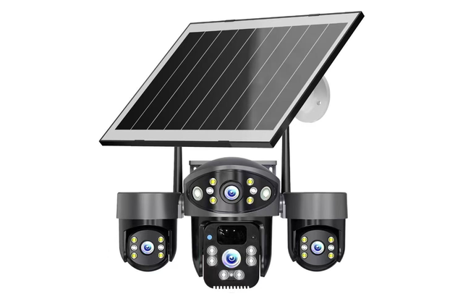
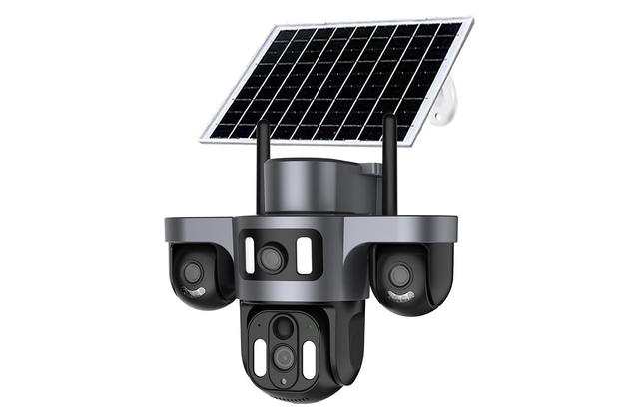
Solar Cameras / 太阳能摄像机
17 / 17
DS-S33
Pixel / 像素: 6MP（1920*1080*3） | APP: Yoosee
• Solar-powered installation / 太阳能供电安装
• AOV low-power monitoring / AOV 低功耗监控
• 4G LTE SIM connectivity / 4G LTE SIM 卡联网
• Remote pan-tilt control / 远程云台控制
• AI human detection & tracking / AI 人形侦测与追踪
33 / 34
DS-S34
Pixel / 像素: 9MP（三个300万镜头） | APP: Yoosee
• Solar-powered installation / 太阳能供电安装
• AOV low-power monitoring / AOV 低功耗监控
• 4G LTE SIM connectivity / 4G LTE SIM 卡联网
• AI human detection & tracking / AI 人形侦测与追踪
• Two-way audio intercom / 双向语音对讲
34 / 34
深圳市东鸿视科技有限公司 | Shenzhen Donghongshi Technology Co., Ltd.
Lily | +86 13715157004 | 19
Notes:
[Sources]
- Workbook 3, Chinese Quotation, row 33
- Workbook 3, Chinese Quotation, row 34
- Workbook 3, Chinese Quotation, row 35
- Workbook 3, Chinese Quotation, row 52
- Workbook 3, Chinese Quotation, row 53
- Workbook 3, Chinese Quotation, row 54

Slide 20
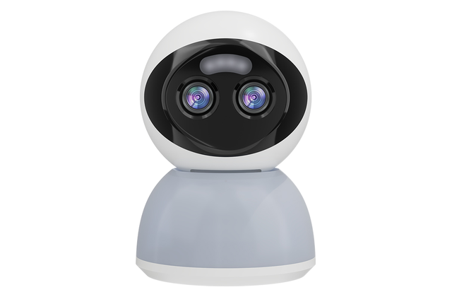
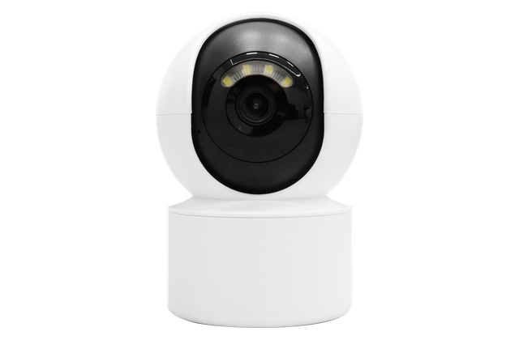
Indoor WiFi Cameras / 长电 WiFi 室内机
01 / 15
DS-L01
Pixel / 像素: 3MP*2镜头-6MP | APP: Carecam Pro
• Continuous-power indoor monitoring / 长电室内持续监控
• 4G LTE and WiFi options / 支持 4G LTE 与 WiFi 版本
• AI human detection & tracking / AI 人形侦测与追踪
• Two-way audio intercom / 双向语音对讲
• TF card and cloud storage / TF卡与云存储
1 / 30
DS-L02
Pixel / 像素: 2MP / 5MP | APP: Carecam Pro
• Continuous-power indoor monitoring / 长电室内持续监控
• WiFi remote viewing / WiFi 远程查看
• AI human detection & tracking / AI 人形侦测与追踪
• Two-way audio intercom / 双向语音对讲
• Infrared night vision / 红外夜视
2 / 30
深圳市东鸿视科技有限公司 | Shenzhen Donghongshi Technology Co., Ltd.
Lily | +86 13715157004 | 20
Notes:
[Sources]
- Workbook 1, 牵心Pro（Carecampro), row 15
- Workbook 1, 牵心Pro（Carecampro), row 27
- Workbook 1, 牵心Pro（Carecampro), row 28

Slide 21
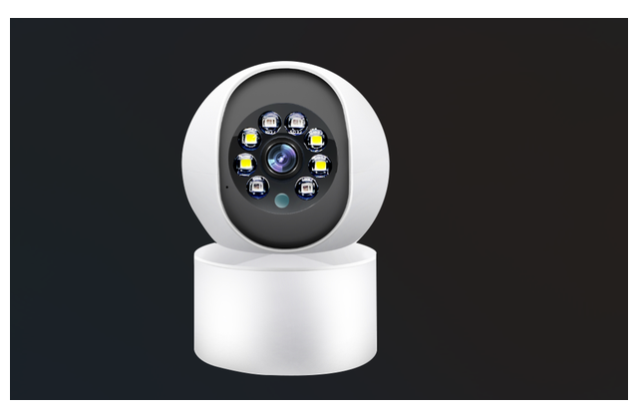
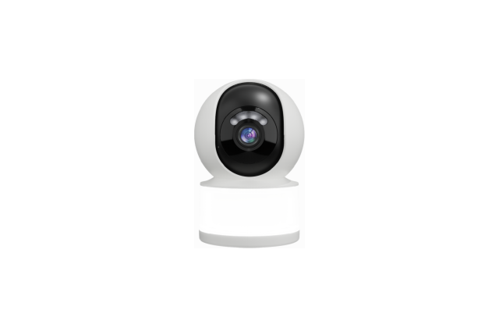
Indoor WiFi Cameras / 长电 WiFi 室内机
02 / 15
DS-L03
Pixel / 像素: 3MP | APP: Carecam Pro
• Continuous-power indoor monitoring / 长电室内持续监控
• WiFi remote viewing / WiFi 远程查看
• AI human detection & tracking / AI 人形侦测与追踪
• Two-way audio intercom / 双向语音对讲
• Infrared night vision / 红外夜视
3 / 30
DS-L04
Pixel / 像素: 3MP / 5MP | APP: Carecam Pro
• Continuous-power indoor monitoring / 长电室内持续监控
• 4G LTE and WiFi options / 支持 4G LTE 与 WiFi 版本
• Smart motion and human detection / 智能移动与人形侦测
• Two-way audio intercom / 双向语音对讲
• TF card and cloud storage / TF卡与云存储
4 / 30
深圳市东鸿视科技有限公司 | Shenzhen Donghongshi Technology Co., Ltd.
Lily | +86 13715157004 | 21
Notes:
[Sources]
- Workbook 1, 牵心Pro（Carecampro), row 29
- Workbook 1, 牵心Pro（Carecampro), row 30
- Workbook 1, 牵心Pro（Carecampro), row 31

Slide 22
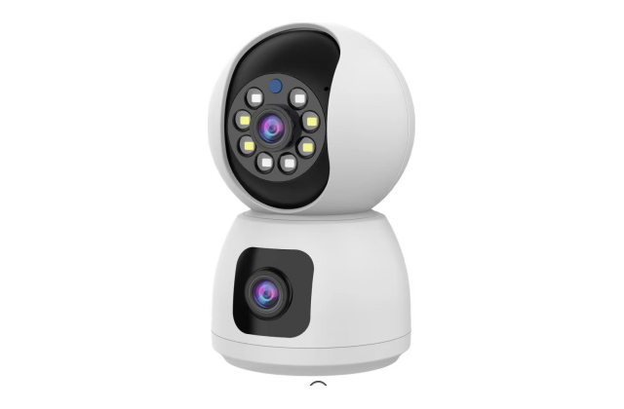
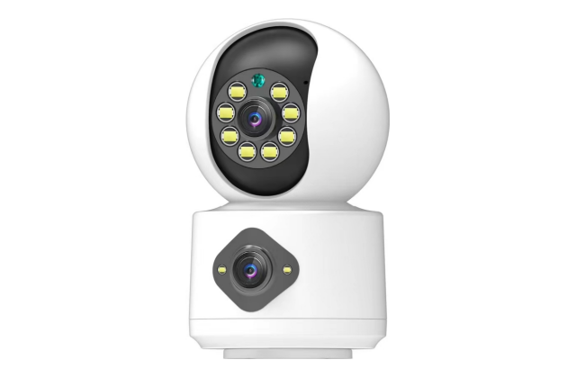
Indoor WiFi Cameras / 长电 WiFi 室内机
03 / 15
DS-L05
Pixel / 像素: 4MP=2MP*2镜头 / 4MP | APP: Carecam Pro / Yoosee
• Continuous-power indoor monitoring / 长电室内持续监控
• Dual-lens dual-view monitoring / 双镜头双画面监控
• AI human detection & tracking / AI 人形侦测与追踪
• Two-way audio intercom / 双向语音对讲
• Infrared night vision / 红外夜视
5 / 30
DS-L06
Pixel / 像素: 4MP=2MP*2镜头 | APP: Carecam Pro
• Continuous-power indoor monitoring / 长电室内持续监控
• Dual-lens dual-view monitoring / 双镜头双画面监控
• AI human detection & tracking / AI 人形侦测与追踪
• Two-way audio intercom / 双向语音对讲
• Infrared night vision / 红外夜视
6 / 30
深圳市东鸿视科技有限公司 | Shenzhen Donghongshi Technology Co., Ltd.
Lily | +86 13715157004 | 22
Notes:
[Sources]
- Workbook 1, 牵心Pro（Carecampro), row 33
- Workbook 3, Chinese Quotation, row 60
- Workbook 1, 牵心Pro（Carecampro), row 34

Slide 23
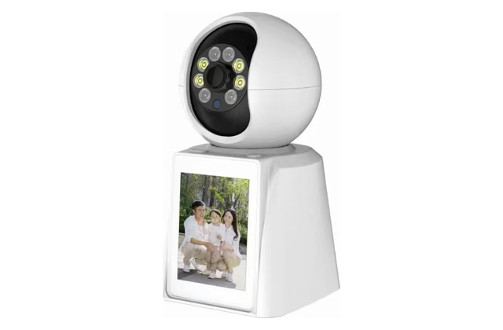
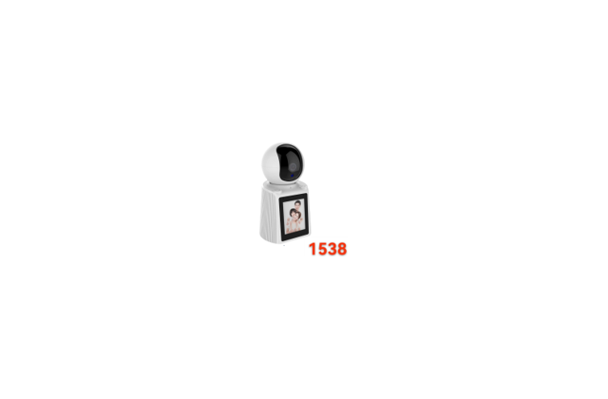
Indoor WiFi Cameras / 长电 WiFi 室内机
04 / 15
DS-L07
Original model / 原型号: 1537
Pixel / 像素: 2MP | APP: V380
• Continuous-power indoor monitoring / 长电室内持续监控
• 4G LTE and WiFi options / 支持 4G LTE 与 WiFi 版本
• Remote pan-tilt control / 远程云台控制
• Smart motion and human detection / 智能移动与人形侦测
• 2.8-inch display / 2.8 英寸显示屏
7 / 30
DS-L08
Original model / 原型号: 1538
Pixel / 像素: 2MP | APP: V380
• Continuous-power indoor monitoring / 长电室内持续监控
• 4G LTE and WiFi options / 支持 4G LTE 与 WiFi 版本
• Remote pan-tilt control / 远程云台控制
• Smart motion and human detection / 智能移动与人形侦测
• 2.8-inch display / 2.8 英寸显示屏
8 / 30
深圳市东鸿视科技有限公司 | Shenzhen Donghongshi Technology Co., Ltd.
Lily | +86 13715157004 | 23
Notes:
[Sources]
- Workbook 2, 摇头机, row 5
- Workbook 2, 摇头机, row 6

Slide 24
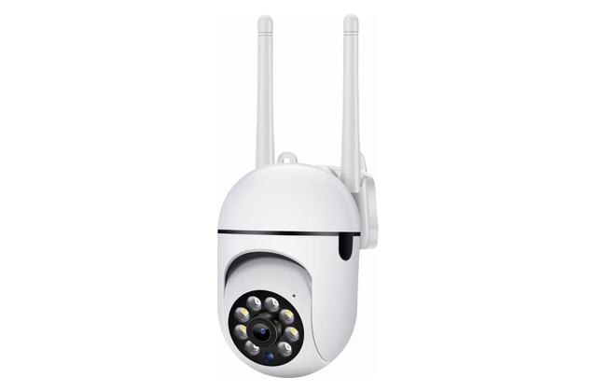
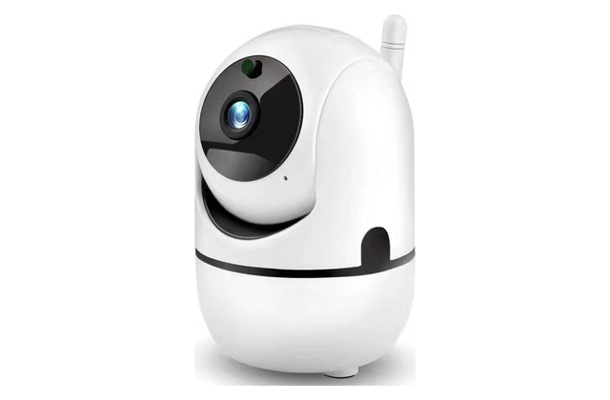
Indoor WiFi Cameras / 长电 WiFi 室内机
05 / 15
DS-L09
Pixel / 像素: 2MP | APP: V380
• Continuous-power indoor monitoring / 长电室内持续监控
• 355° pan & 100° tilt / 355° 水平与 100° 垂直云台
• Smart motion and human detection / 智能移动与人形侦测
• Two-way audio intercom / 双向语音对讲
• Infrared night vision / 红外夜视
9 / 30
DS-L10
Pixel / 像素: 2MP | APP: V380
• Continuous-power indoor monitoring / 长电室内持续监控
• 355° pan & 100° tilt / 355° 水平与 100° 垂直云台
• Smart motion and human detection / 智能移动与人形侦测
• Two-way audio intercom / 双向语音对讲
• Infrared night vision / 红外夜视
10 / 30
深圳市东鸿视科技有限公司 | Shenzhen Donghongshi Technology Co., Ltd.
Lily | +86 13715157004 | 24
Notes:
[Sources]
- Workbook 2, 摇头机, row 8
- Workbook 2, 摇头机, row 9

Slide 25
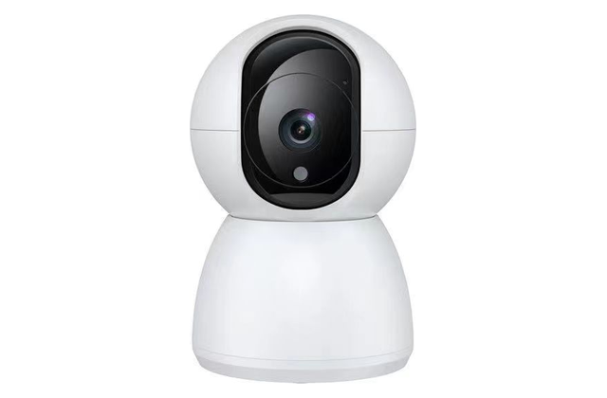
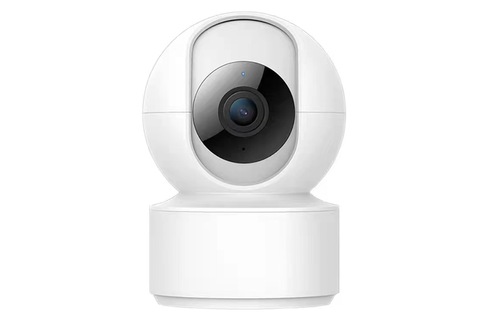
Indoor WiFi Cameras / 长电 WiFi 室内机
06 / 15
DS-L11
Pixel / 像素: 2MP | APP: V380
• Continuous-power indoor monitoring / 长电室内持续监控
• 355° pan & 100° tilt / 355° 水平与 100° 垂直云台
• Smart motion and human detection / 智能移动与人形侦测
• Two-way audio intercom / 双向语音对讲
• Infrared night vision / 红外夜视
11 / 30
DS-L12
Pixel / 像素: 2MP | APP: V380
• Continuous-power indoor monitoring / 长电室内持续监控
• 355° pan & 100° tilt / 355° 水平与 100° 垂直云台
• Smart motion and human detection / 智能移动与人形侦测
• Two-way audio intercom / 双向语音对讲
• Infrared night vision / 红外夜视
12 / 30
深圳市东鸿视科技有限公司 | Shenzhen Donghongshi Technology Co., Ltd.
Lily | +86 13715157004 | 25
Notes:
[Sources]
- Workbook 2, 摇头机, row 10
- Workbook 2, 摇头机, row 11

Slide 26
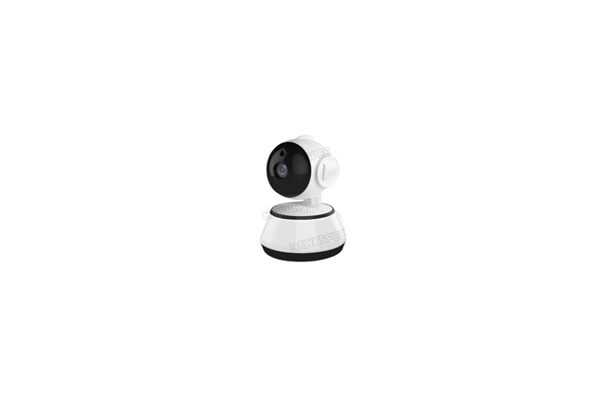
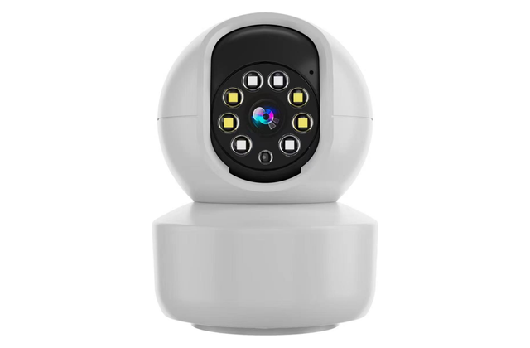
Indoor WiFi Cameras / 长电 WiFi 室内机
07 / 15
DS-L13
Pixel / 像素: 2MP | APP: V380
• Continuous-power indoor monitoring / 长电室内持续监控
• 355° pan & 100° tilt / 355° 水平与 100° 垂直云台
• Smart motion and human detection / 智能移动与人形侦测
• Two-way audio intercom / 双向语音对讲
• Infrared night vision / 红外夜视
13 / 30
DS-L14
Pixel / 像素: 2MP | APP: V380
• Continuous-power indoor monitoring / 长电室内持续监控
• 355° pan & 100° tilt / 355° 水平与 100° 垂直云台
• Smart motion and human detection / 智能移动与人形侦测
• Two-way audio intercom / 双向语音对讲
• Infrared night vision / 红外夜视
14 / 30
深圳市东鸿视科技有限公司 | Shenzhen Donghongshi Technology Co., Ltd.
Lily | +86 13715157004 | 26
Notes:
[Sources]
- Workbook 2, 摇头机, row 12
- Workbook 2, 摇头机, row 13

Slide 27
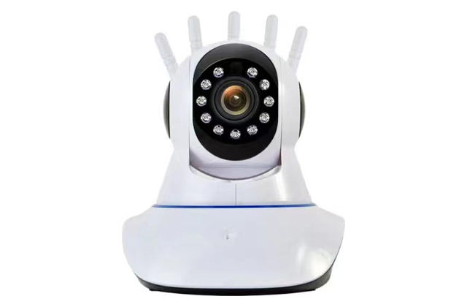
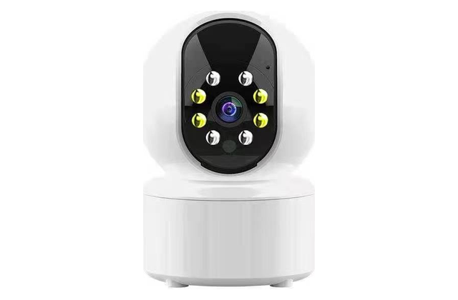
Indoor WiFi Cameras / 长电 WiFi 室内机
08 / 15
DS-L15
Pixel / 像素: 2MP | APP: V380
• Continuous-power indoor monitoring / 长电室内持续监控
• 355° pan & 100° tilt / 355° 水平与 100° 垂直云台
• Smart motion and human detection / 智能移动与人形侦测
• Two-way audio intercom / 双向语音对讲
• Infrared night vision / 红外夜视
15 / 30
DS-L16
Pixel / 像素: 2MP | APP: V380
• Continuous-power indoor monitoring / 长电室内持续监控
• 355° pan & 100° tilt / 355° 水平与 100° 垂直云台
• Smart motion and human detection / 智能移动与人形侦测
• Two-way audio intercom / 双向语音对讲
• Infrared night vision / 红外夜视
16 / 30
深圳市东鸿视科技有限公司 | Shenzhen Donghongshi Technology Co., Ltd.
Lily | +86 13715157004 | 27
Notes:
[Sources]
- Workbook 2, 摇头机, row 14
- Workbook 2, 摇头机, row 15

Slide 28


Indoor WiFi Dual Lens Cameras / 长电 WiFi 双镜头 室内机
09 / 15
DS-L17
Pixel / 像素: 2MP+2MP | APP: V380
• Continuous-power indoor monitoring / 长电室内持续监控
• Dual-lens dual-view monitoring / 双镜头双画面监控
• 355° pan & 100° tilt / 355° 水平与 100° 垂直云台
• Smart motion and human detection / 智能移动与人形侦测
• Two-way audio intercom / 双向语音对讲
17 / 30
DS-L18
Pixel / 像素: 2MP+2MP | APP: V380
• Continuous-power indoor monitoring / 长电室内持续监控
• Dual-lens dual-view monitoring / 双镜头双画面监控
• 355° pan & 100° tilt / 355° 水平与 100° 垂直云台
• Smart motion and human detection / 智能移动与人形侦测
• Two-way audio intercom / 双向语音对讲
18 / 30
深圳市东鸿视科技有限公司 | Shenzhen Donghongshi Technology Co., Ltd.
Lily | +86 13715157004 | 28
Notes:
[Sources]
- Workbook 2, 摇头机, row 17
- Workbook 2, 摇头机, row 19

Slide 29


Indoor WiFi Dual Lens Cameras / 长电 WiFi 双镜头室内机
10 / 15
DS-L19
Pixel / 像素: 2MP+2MP | APP: V380
• Continuous-power indoor monitoring / 长电室内持续监控
• Dual-lens dual-view monitoring / 双镜头双画面监控
• 355° pan & 100° tilt / 355° 水平与 100° 垂直云台
• Smart motion and human detection / 智能移动与人形侦测
• Two-way audio intercom / 双向语音对讲
19 / 30
DS-L20
Pixel / 像素: 2MP+2MP | APP: V380
• Continuous-power indoor monitoring / 长电室内持续监控
• Dual-lens dual-view monitoring / 双镜头双画面监控
• 355° pan & 100° tilt / 355° 水平与 100° 垂直云台
• Smart motion and human detection / 智能移动与人形侦测
• Two-way audio intercom / 双向语音对讲
20 / 30
深圳市东鸿视科技有限公司 | Shenzhen Donghongshi Technology Co., Ltd.
Lily | +86 13715157004 | 29
Notes:
[Sources]
- Workbook 2, 摇头机, row 20
- Workbook 2, 摇头机, row 21

Slide 30


Indoor WiFi Cameras / 长电 WiFi 室内机
11 / 15
DS-L21
Original model / 原型号: YY-Y610A(5V)
Pixel / 像素: 2MP | APP: Yoosee
• Continuous-power indoor monitoring / 长电室内持续监控
• 4G LTE and WiFi options / 支持 4G LTE 与 WiFi 版本
• 355° pan & 90° tilt / 355° 水平与 90° 垂直云台
• Smart motion and human detection / 智能移动与人形侦测
• Two-way audio intercom / 双向语音对讲
21 / 30
DS-L22
Original model / 原型号: YY-Y611A月牙（5V)
Pixel / 像素: 2MP | APP: Yoosee
• Continuous-power indoor monitoring / 长电室内持续监控
• 4G LTE and WiFi options / 支持 4G LTE 与 WiFi 版本
• 355° pan & 90° tilt / 355° 水平与 90° 垂直云台
• Smart motion and human detection / 智能移动与人形侦测
• Two-way audio intercom / 双向语音对讲
22 / 30
深圳市东鸿视科技有限公司 | Shenzhen Donghongshi Technology Co., Ltd.
Lily | +86 13715157004 | 30
Notes:
[Sources]
- Workbook 3, Chinese Quotation, row 56
- Workbook 3, Chinese Quotation, row 57

Slide 31


Indoor WiFi Cameras / 长电 WiFi 室内机
12 / 15
DS-L23
Pixel / 像素: 2MP | APP: Yoosee
• Continuous-power indoor monitoring / 长电室内持续监控
• 4G LTE and WiFi options / 支持 4G LTE 与 WiFi 版本
• 355° pan & 90° tilt / 355° 水平与 90° 垂直云台
• Smart motion and human detection / 智能移动与人形侦测
• Two-way audio intercom / 双向语音对讲
23 / 30
DS-L24
Pixel / 像素: 2MP | APP: Yoosee
• Continuous-power indoor monitoring / 长电室内持续监控
• 4G LTE and WiFi options / 支持 4G LTE 与 WiFi 版本
• 355° pan & 90° tilt / 355° 水平与 90° 垂直云台
• Smart motion and human detection / 智能移动与人形侦测
• Two-way audio intercom / 双向语音对讲
24 / 30
深圳市东鸿视科技有限公司 | Shenzhen Donghongshi Technology Co., Ltd.
Lily | +86 13715157004 | 31
Notes:
[Sources]
- Workbook 3, Chinese Quotation, row 58
- Workbook 3, Chinese Quotation, row 59

Slide 32


Indoor WiFi Dual Lens Cameras / 长电 WiFi 双镜头室内机
13 / 15
DS-L25
Pixel / 像素: 4MP | APP: Yoosee
• Continuous-power indoor monitoring / 长电室内持续监控
• 4G LTE and WiFi options / 支持 4G LTE 与 WiFi 版本
• 355° pan & 90° tilt / 355° 水平与 90° 垂直云台
• Smart motion and human detection / 智能移动与人形侦测
• Two-way audio intercom / 双向语音对讲
25 / 30
DS-L26
Pixel / 像素: 4MP | APP: Yoosee
• Continuous-power indoor monitoring / 长电室内持续监控
• 4G LTE and WiFi options / 支持 4G LTE 与 WiFi 版本
• 355° pan & 90° tilt / 355° 水平与 90° 垂直云台
• Smart motion and human detection / 智能移动与人形侦测
• Two-way audio intercom / 双向语音对讲
26 / 30
深圳市东鸿视科技有限公司 | Shenzhen Donghongshi Technology Co., Ltd.
Lily | +86 13715157004 | 32
Notes:
[Sources]
- Workbook 3, Chinese Quotation, row 61
- Workbook 3, Chinese Quotation, row 62

Slide 33


Indoor WiFi Cameras / 长电 WiFi 室内机
14 / 15
DS-L27
Pixel / 像素: 4MP | APP: Yoosee
• Continuous-power indoor monitoring / 长电室内持续监控
• 4G LTE and WiFi options / 支持 4G LTE 与 WiFi 版本
• 355° pan & 90° tilt / 355° 水平与 90° 垂直云台
• Smart motion and human detection / 智能移动与人形侦测
• Two-way audio intercom / 双向语音对讲
27 / 30
DS-L28
Pixel / 像素: — | APP: IM CAM
• Continuous-power indoor monitoring / 长电室内持续监控
• WiFi remote viewing / WiFi 远程查看
• AI human detection & tracking / AI 人形侦测与追踪
• One-touch video calling / 一键视频通话
• 2.8-inch display / 2.8 英寸显示屏
28 / 30
深圳市东鸿视科技有限公司 | Shenzhen Donghongshi Technology Co., Ltd.
Lily | +86 13715157004 | 33
Notes:
[Sources]
- Workbook 3, Chinese Quotation, row 63
- Workbook 1, 看家王（Imcam), row 4
- Workbook 1, 看家王（Imcam), row 5

Slide 34


Video Calling Cameras / 视频摄像机
15 / 15
DS-L29
Pixel / 像素: — | APP: IM CAM / 牵心PRO（Carecam pro)
• Continuous-power indoor monitoring / 长电室内持续监控
• 4G LTE and WiFi options / 支持 4G LTE 与 WiFi 版本
• AI human detection & tracking / AI 人形侦测与追踪
• One-touch video calling / 一键视频通话
• 2.8-inch display / 2.8 英寸显示屏
29 / 30
DS-L30
Pixel / 像素: 2MP | APP: IM CAM / Yoosee
• Continuous-power indoor monitoring / 长电室内持续监控
• AI human detection & tracking / AI 人形侦测与追踪
• One-touch video calling / 一键视频通话
• 2.8-inch display / 2.8 英寸显示屏
• Infrared night vision / 红外夜视
30 / 30
深圳市东鸿视科技有限公司 | Shenzhen Donghongshi Technology Co., Ltd.
Lily | +86 13715157004 | 34
Notes:
[Sources]
- Workbook 1, 看家王（Imcam), row 6
- Workbook 1, 看家王（Imcam), row 7
- Workbook 1, 看家王（Imcam), row 14
- Workbook 1, 看家王（Imcam), row 16
- Workbook 1, 看家王（Imcam), row 8
- Workbook 1, 看家王（Imcam), row 9
- Workbook 1, 看家王（Imcam), row 10
- Workbook 1, 看家王（Imcam), row 12
- Workbook 3, Chinese Quotation, row 10

Slide 35


Outdoor Cameras / 长电室内摇头机
11 / 44
DS-L21
Pixel / 像素: 2MP | APP: Carecam Pro
• Outdoor professional monitoring / 专业室外监控
• 4G LTE and WiFi options / 支持 4G LTE 与 WiFi 版本
• AI human detection & tracking / AI 人形侦测与追踪
• Two-way audio intercom / 双向语音对讲
• Outdoor installation design / 适合室外安装
21 / 87
DS-L22
Pixel / 像素: 3MP | APP: Carecam Pro
• Outdoor professional monitoring / 专业室外监控
• WiFi remote viewing / WiFi 远程查看
• AI human detection & tracking / AI 人形侦测与追踪
• Two-way audio intercom / 双向语音对讲
• Infrared night vision / 红外夜视
22 / 87
深圳市东鸿视科技有限公司 | Shenzhen Donghongshi Technology Co., Ltd.
Lily | +86 13715157004 | 45
Notes:
[Sources]
- Workbook 1, 牵心Pro（Carecampro), row 32
- Workbook 1, 牵心Pro（Carecampro), row 35

Slide 36


Outdoor Cameras / 长电室外机
01 / 44
DS-P01
Pixel / 像素: 4MP | APP: Yoosee
• Outdoor professional monitoring / 专业室外监控
• 4G LTE and WiFi options / 支持 4G LTE 与 WiFi 版本
• 355° pan & 90° tilt / 355° 水平与 90° 垂直云台
• Smart motion and human detection / 智能移动与人形侦测
• Two-way audio intercom / 双向语音对讲
1 / 87
DS-P02(10X Zoom)
Pixel / 像素: 8MP=2MP*4镜头 | APP: Carecam Pro
• Outdoor professional monitoring / 专业室外监控
• AI human detection & tracking / AI 人形侦测与追踪
• Two-way audio intercom / 双向语音对讲
• Outdoor installation design / 适合室外安装
• TF card and cloud storage / TF卡与云存储
2 / 87
深圳市东鸿视科技有限公司 | Shenzhen Donghongshi Technology Co., Ltd.
Lily | +86 13715157004 | 35
Notes:
[Sources]
- Workbook 3, Chinese Quotation, row 16
- Workbook 1, 牵心Pro（Carecampro), row 4

Slide 37


Outdoor Cameras / 长电室外机
02 / 44
DS-P03(10X Zoom)
Pixel / 像素: 8MP=2MP*4镜头 | APP: Carecam Pro
• Outdoor professional monitoring / 专业室外监控
• AI human detection & tracking / AI 人形侦测与追踪
• Two-way audio intercom / 双向语音对讲
• Outdoor installation design / 适合室外安装
• TF card and cloud storage / TF卡与云存储
3 / 87
DS-P04
Pixel / 像素: 4MP=2MP*2镜头 / 4MP | APP: Carecam Pro / Yoosee
• Outdoor professional monitoring / 专业室外监控
• AI human detection & tracking / AI 人形侦测与追踪
• Two-way audio intercom / 双向语音对讲
• Infrared night vision / 红外夜视
• Outdoor installation design / 适合室外安装
4 / 87
深圳市东鸿视科技有限公司 | Shenzhen Donghongshi Technology Co., Ltd.
Lily | +86 13715157004 | 36
Notes:
[Sources]
- Workbook 1, 牵心Pro（Carecampro), row 5
- Workbook 1, 牵心Pro（Carecampro), row 6
- Workbook 3, Chinese Quotation, row 41

Slide 38


Outdoor Cameras / 长电室外机
03 / 44
DS-P05
Pixel / 像素: 4MP=2MP*2镜头 | APP: Carecam Pro
• Outdoor professional monitoring / 专业室外监控
• WiFi remote viewing / WiFi 远程查看
• AI human detection & tracking / AI 人形侦测与追踪
• Two-way audio intercom / 双向语音对讲
• Infrared night vision / 红外夜视
5 / 87
DS-P06
Pixel / 像素: 4MP=2MP*2镜头 | APP: Carecam Pro
• Outdoor professional monitoring / 专业室外监控
• WiFi remote viewing / WiFi 远程查看
• AI human detection & tracking / AI 人形侦测与追踪
• Two-way audio intercom / 双向语音对讲
• Infrared night vision / 红外夜视
6 / 87
深圳市东鸿视科技有限公司 | Shenzhen Donghongshi Technology Co., Ltd.
Lily | +86 13715157004 | 37
Notes:
[Sources]
- Workbook 1, 牵心Pro（Carecampro), row 7
- Workbook 1, 牵心Pro（Carecampro), row 8

Slide 39


Outdoor Cameras / 长电室外机
04 / 44
DS-P07
Pixel / 像素: 4MP=2MP*2镜头 | APP: Carecam Pro
• Outdoor professional monitoring / 专业室外监控
• AI human detection & tracking / AI 人形侦测与追踪
• Two-way audio intercom / 双向语音对讲
• Infrared night vision / 红外夜视
• Outdoor installation design / 适合室外安装
7 / 87
DS-P08
Pixel / 像素: 4MP=2MP*2镜头 | APP: Carecam Pro
• Outdoor professional monitoring / 专业室外监控
• AI human detection & tracking / AI 人形侦测与追踪
• Two-way audio intercom / 双向语音对讲
• Infrared night vision / 红外夜视
• Outdoor installation design / 适合室外安装
8 / 87
深圳市东鸿视科技有限公司 | Shenzhen Donghongshi Technology Co., Ltd.
Lily | +86 13715157004 | 38
Notes:
[Sources]
- Workbook 1, 牵心Pro（Carecampro), row 9
- Workbook 1, 牵心Pro（Carecampro), row 10

Slide 40


Outdoor Cameras / 长电室外机
05 / 44
DS-P09
Pixel / 像素: 4MP=2MP*2镜头 | APP: Carecam Pro
• Outdoor professional monitoring / 专业室外监控
• AI human detection & tracking / AI 人形侦测与追踪
• Two-way audio intercom / 双向语音对讲
• Infrared night vision / 红外夜视
• Outdoor installation design / 适合室外安装
9 / 87
DS-P10
Pixel / 像素: 4MP=2MP*2镜头 / 4MP | APP: Carecam Pro / Yoosee
• Outdoor professional monitoring / 专业室外监控
• AI human detection & tracking / AI 人形侦测与追踪
• Two-way audio intercom / 双向语音对讲
• Infrared night vision / 红外夜视
• Outdoor installation design / 适合室外安装
10 / 87
深圳市东鸿视科技有限公司 | Shenzhen Donghongshi Technology Co., Ltd.
Lily | +86 13715157004 | 39
Notes:
[Sources]
- Workbook 1, 牵心Pro（Carecampro), row 11
- Workbook 1, 牵心Pro（Carecampro), row 12
- Workbook 3, Chinese Quotation, row 47

Slide 41


Outdoor Cameras / 长电室外机
06 / 44
DS-P11(10X Zoom）
Pixel / 像素: 3MP*2镜头-6MP | APP: Carecam Pro
• Outdoor professional monitoring / 专业室外监控
• Dual-lens dual-view monitoring / 双镜头双画面监控
• Smart motion and human detection / 智能移动与人形侦测
• Two-way audio intercom / 双向语音对讲
• Infrared night vision / 红外夜视
11 / 87
DS-P12（10X Zoom)
Pixel / 像素: 3MP*2镜头-6MP | APP: Carecam Pro
• Outdoor professional monitoring / 专业室外监控
• Dual-lens dual-view monitoring / 双镜头双画面监控
• Smart motion and human detection / 智能移动与人形侦测
• Two-way audio intercom / 双向语音对讲
• 15m infrared night vision / 15米红外夜视
12 / 87
深圳市东鸿视科技有限公司 | Shenzhen Donghongshi Technology Co., Ltd.
Lily | +86 13715157004 | 40
Notes:
[Sources]
- Workbook 1, 牵心Pro（Carecampro), row 13
- Workbook 1, 牵心Pro（Carecampro), row 14

Slide 42


Outdoor Cameras / 长电室外机
07 / 44
DS-P13
Pixel / 像素: 5MP | APP: Carecam Pro
• Outdoor professional monitoring / 专业室外监控
• AI human detection & tracking / AI 人形侦测与追踪
• Two-way audio intercom / 双向语音对讲
• Outdoor installation design / 适合室外安装
• TF card and cloud storage / TF卡与云存储
13 / 87
DS-P14
Pixel / 像素: 5MP | APP: Carecam Pro
• Outdoor professional monitoring / 专业室外监控
• AI human detection & tracking / AI 人形侦测与追踪
• Two-way audio intercom / 双向语音对讲
• Outdoor installation design / 适合室外安装
• TF card and cloud storage / TF卡与云存储
14 / 87
深圳市东鸿视科技有限公司 | Shenzhen Donghongshi Technology Co., Ltd.
Lily | +86 13715157004 | 41
Notes:
[Sources]
- Workbook 1, 牵心Pro（Carecampro), row 16
- Workbook 1, 牵心Pro（Carecampro), row 17

Slide 43


Outdoor Cameras / 长电室外机
08 / 44
DS-P15
Pixel / 像素: 2MP | APP: Carecam Pro
• Outdoor professional monitoring / 专业室外监控
• Smart motion and human detection / 智能移动与人形侦测
• Two-way audio intercom / 双向语音对讲
• 1.5-inch display / 1.5 英寸显示屏
• Smart dual-light full-color night vision / 智能双光全彩夜视
15 / 87
DS-P16
Pixel / 像素: 3MP / 5MP / 2MP | APP: Carecam Pro / Yoosee
• Outdoor professional monitoring / 专业室外监控
• AI human detection & tracking / AI 人形侦测与追踪
• Two-way audio intercom / 双向语音对讲
• 2.5-inch display / 2.5 英寸显示屏
• Outdoor installation design / 适合室外安装
16 / 87
深圳市东鸿视科技有限公司 | Shenzhen Donghongshi Technology Co., Ltd.
Lily | +86 13715157004 | 42
Notes:
[Sources]
- Workbook 1, 牵心Pro（Carecampro), row 18
- Workbook 1, 牵心Pro（Carecampro), row 19
- Workbook 1, 牵心Pro（Carecampro), row 20
- Workbook 3, Chinese Quotation, row 64

Slide 44


Outdoor Cameras / 长电室外机
09 / 44
DS-P17
Pixel / 像素: 5MP | APP: Carecam Pro
• Outdoor professional monitoring / 专业室外监控
• AI human detection & tracking / AI 人形侦测与追踪
• Two-way audio intercom / 双向语音对讲
• 2.5-inch display / 2.5 英寸显示屏
• Outdoor installation design / 适合室外安装
17 / 87
DS-P18
Pixel / 像素: 3MP | APP: Carecam Pro
• Outdoor professional monitoring / 专业室外监控
• Smart motion and human detection / 智能移动与人形侦测
• Two-way audio intercom / 双向语音对讲
• 2-inch display / 2 英寸显示屏
• Smart dual-light full-color night vision / 智能双光全彩夜视
18 / 87
深圳市东鸿视科技有限公司 | Shenzhen Donghongshi Technology Co., Ltd.
Lily | +86 13715157004 | 43
Notes:
[Sources]
- Workbook 1, 牵心Pro（Carecampro), row 21
- Workbook 1, 牵心Pro（Carecampro), row 22

Slide 45


Outdoor Cameras / 长电室外机
10 / 44
DS-P19
Pixel / 像素: 2MP | APP: Carecam Pro
• Outdoor professional monitoring / 专业室外监控
• WiFi remote viewing / WiFi 远程查看
• AI human detection & tracking / AI 人形侦测与追踪
• Two-way audio intercom / 双向语音对讲
• Infrared night vision / 红外夜视
19 / 87
DS-P20
Pixel / 像素: 3MP | APP: Carecam Pro
• Outdoor professional monitoring / 专业室外监控
• AI human detection & tracking / AI 人形侦测与追踪
• Two-way audio intercom / 双向语音对讲
• 2.5-inch display / 2.5 英寸显示屏
• Outdoor installation design / 适合室外安装
20 / 87
深圳市东鸿视科技有限公司 | Shenzhen Donghongshi Technology Co., Ltd.
Lily | +86 13715157004 | 44
Notes:
[Sources]
- Workbook 1, 牵心Pro（Carecampro), row 23
- Workbook 1, 牵心Pro（Carecampro), row 24

Slide 46


Outdoor Cameras / 长电室外机
12 / 44
DS-P23
Pixel / 像素: 3MP | APP: Carecam Pro
• Outdoor professional monitoring / 专业室外监控
• Dual-lens dual-view monitoring / 双镜头双画面监控
• Remote pan-tilt control / 远程云台控制
• AI human detection & tracking / AI 人形侦测与追踪
• Two-way audio intercom / 双向语音对讲
23 / 87
DS-P24
Pixel / 像素: 2MP | APP: V380 Pro
• Outdoor professional monitoring / 专业室外监控
• 4G LTE and WiFi options / 支持 4G LTE 与 WiFi 版本
• 355° pan & 100° tilt / 355° 水平与 100° 垂直云台
• Smart motion and human detection / 智能移动与人形侦测
• Two-way audio intercom / 双向语音对讲
24 / 87
深圳市东鸿视科技有限公司 | Shenzhen Donghongshi Technology Co., Ltd.
Lily | +86 13715157004 | 46
Notes:
[Sources]
- Workbook 1, 牵心Pro（Carecampro), row 36
- Workbook 2, 球机, row 4
- Workbook 2, 球机, row 5

Slide 47


Outdoor Cameras / 长电室外机
13 / 44
DS-P25
Pixel / 像素: 2MP | APP: V380 Pro
• Outdoor professional monitoring / 专业室外监控
• 4G LTE and WiFi options / 支持 4G LTE 与 WiFi 版本
• 355° pan & 100° tilt / 355° 水平与 100° 垂直云台
• Smart motion and human detection / 智能移动与人形侦测
• Two-way audio intercom / 双向语音对讲
25 / 87
DS-P26
Pixel / 像素: 2MP | APP: V380 Pro
• Outdoor professional monitoring / 专业室外监控
• 4G LTE and WiFi options / 支持 4G LTE 与 WiFi 版本
• 355° pan & 100° tilt / 355° 水平与 100° 垂直云台
• Smart motion and human detection / 智能移动与人形侦测
• Two-way audio intercom / 双向语音对讲
26 / 87
深圳市东鸿视科技有限公司 | Shenzhen Donghongshi Technology Co., Ltd.
Lily | +86 13715157004 | 47
Notes:
[Sources]
- Workbook 2, 球机, row 6
- Workbook 2, 球机, row 7
- Workbook 2, 球机, row 8
- Workbook 2, 球机, row 9

Slide 48


Outdoor Cameras / 长电室外机
14 / 44
DS-P27
Pixel / 像素: 2MP | APP: V380 Pro
• Outdoor professional monitoring / 专业室外监控
• 4G LTE and WiFi options / 支持 4G LTE 与 WiFi 版本
• 355° pan & 100° tilt / 355° 水平与 100° 垂直云台
• Smart motion and human detection / 智能移动与人形侦测
• Two-way audio intercom / 双向语音对讲
27 / 87
DS-P28
Pixel / 像素: 2MP | APP: V380 Pro
• Outdoor professional monitoring / 专业室外监控
• 4G LTE and WiFi options / 支持 4G LTE 与 WiFi 版本
• 355° pan & 100° tilt / 355° 水平与 100° 垂直云台
• Smart motion and human detection / 智能移动与人形侦测
• Two-way audio intercom / 双向语音对讲
28 / 87
深圳市东鸿视科技有限公司 | Shenzhen Donghongshi Technology Co., Ltd.
Lily | +86 13715157004 | 48
Notes:
[Sources]
- Workbook 2, 球机, row 10
- Workbook 2, 球机, row 11
- Workbook 2, 球机, row 12
- Workbook 2, 球机, row 13

Slide 49


Outdoor Cameras / 长电室外机
15 / 44
DS-P29
Pixel / 像素: 2MP | APP: V380 Pro
• Outdoor professional monitoring / 专业室外监控
• 4G LTE and WiFi options / 支持 4G LTE 与 WiFi 版本
• 355° pan & 100° tilt / 355° 水平与 100° 垂直云台
• Smart motion and human detection / 智能移动与人形侦测
• Two-way audio intercom / 双向语音对讲
29 / 87
DS-P30
Pixel / 像素: 2MP | APP: V380 Pro
• Outdoor professional monitoring / 专业室外监控
• 4G LTE and WiFi options / 支持 4G LTE 与 WiFi 版本
• 355° pan & 100° tilt / 355° 水平与 100° 垂直云台
• Smart motion and human detection / 智能移动与人形侦测
• Two-way audio intercom / 双向语音对讲
30 / 87
深圳市东鸿视科技有限公司 | Shenzhen Donghongshi Technology Co., Ltd.
Lily | +86 13715157004 | 49
Notes:
[Sources]
- Workbook 2, 球机, row 14
- Workbook 2, 球机, row 15
- Workbook 2, 球机, row 16
- Workbook 2, 球机, row 17

Slide 50


Outdoor Cameras / 长电室外机
16 / 44
DS-P31
Pixel / 像素: 2MP | APP: V380 Pro
• Outdoor professional monitoring / 专业室外监控
• 4G LTE and WiFi options / 支持 4G LTE 与 WiFi 版本
• 355° pan & 100° tilt / 355° 水平与 100° 垂直云台
• Smart motion and human detection / 智能移动与人形侦测
• Two-way audio intercom / 双向语音对讲
31 / 87
DS-P32
Pixel / 像素: 2MP | APP: V380 Pro
• Outdoor professional monitoring / 专业室外监控
• 4G LTE and WiFi options / 支持 4G LTE 与 WiFi 版本
• 355° pan & 100° tilt / 355° 水平与 100° 垂直云台
• Smart motion and human detection / 智能移动与人形侦测
• Two-way audio intercom / 双向语音对讲
32 / 87
深圳市东鸿视科技有限公司 | Shenzhen Donghongshi Technology Co., Ltd.
Lily | +86 13715157004 | 50
Notes:
[Sources]
- Workbook 2, 球机, row 18
- Workbook 2, 球机, row 19
- Workbook 2, 球机, row 20
- Workbook 2, 球机, row 21

Slide 51


Outdoor Cameras / 长电室外机
17 / 44
DS-P33
Pixel / 像素: 2MP | APP: V380 Pro
• Outdoor professional monitoring / 专业室外监控
• 4G LTE and WiFi options / 支持 4G LTE 与 WiFi 版本
• 355° pan & 100° tilt / 355° 水平与 100° 垂直云台
• Smart motion and human detection / 智能移动与人形侦测
• Two-way audio intercom / 双向语音对讲
33 / 87
DS-P34
Pixel / 像素: 2MP | APP: V380 Pro
• Outdoor professional monitoring / 专业室外监控
• 4G LTE and WiFi options / 支持 4G LTE 与 WiFi 版本
• 355° pan & 100° tilt / 355° 水平与 100° 垂直云台
• Smart motion and human detection / 智能移动与人形侦测
• Two-way audio intercom / 双向语音对讲
34 / 87
深圳市东鸿视科技有限公司 | Shenzhen Donghongshi Technology Co., Ltd.
Lily | +86 13715157004 | 51
Notes:
[Sources]
- Workbook 2, 球机, row 22
- Workbook 2, 球机, row 23
- Workbook 2, 球机, row 24
- Workbook 2, 球机, row 25

Slide 52


Outdoor Cameras / 长电室外机
18 / 44
DS-P35
Pixel / 像素: 2MP | APP: V380 Pro
• Outdoor professional monitoring / 专业室外监控
• 4G LTE and WiFi options / 支持 4G LTE 与 WiFi 版本
• 355° pan & 100° tilt / 355° 水平与 100° 垂直云台
• Smart motion and human detection / 智能移动与人形侦测
• Two-way audio intercom / 双向语音对讲
35 / 87
DS-P36
Pixel / 像素: 2MP | APP: V380 Pro
• Outdoor professional monitoring / 专业室外监控
• 4G LTE and WiFi options / 支持 4G LTE 与 WiFi 版本
• 355° pan & 100° tilt / 355° 水平与 100° 垂直云台
• Smart motion and human detection / 智能移动与人形侦测
• Two-way audio intercom / 双向语音对讲
36 / 87
深圳市东鸿视科技有限公司 | Shenzhen Donghongshi Technology Co., Ltd.
Lily | +86 13715157004 | 52
Notes:
[Sources]
- Workbook 2, 球机, row 26
- Workbook 2, 球机, row 27
- Workbook 2, 球机, row 28
- Workbook 2, 球机, row 29

Slide 53


Outdoor Cameras / 长电室外机
19 / 44
DS-P37
Pixel / 像素: 2MP | APP: V380 Pro
• Outdoor professional monitoring / 专业室外监控
• 4G LTE and WiFi options / 支持 4G LTE 与 WiFi 版本
• 355° pan & 100° tilt / 355° 水平与 100° 垂直云台
• Smart motion and human detection / 智能移动与人形侦测
• Two-way audio intercom / 双向语音对讲
37 / 87
DS-P38
Pixel / 像素: 2MP | APP: V380 Pro
• Outdoor professional monitoring / 专业室外监控
• 4G LTE and WiFi options / 支持 4G LTE 与 WiFi 版本
• 355° pan & 100° tilt / 355° 水平与 100° 垂直云台
• Smart motion and human detection / 智能移动与人形侦测
• Two-way audio intercom / 双向语音对讲
38 / 87
深圳市东鸿视科技有限公司 | Shenzhen Donghongshi Technology Co., Ltd.
Lily | +86 13715157004 | 53
Notes:
[Sources]
- Workbook 2, 球机, row 30
- Workbook 2, 球机, row 31
- Workbook 2, 球机, row 32
- Workbook 2, 球机, row 33

Slide 54


Outdoor Cameras / 长电室外机
20 / 44
DS-P39
Pixel / 像素: 2MP | APP: V380 Pro
• Outdoor professional monitoring / 专业室外监控
• 4G LTE and WiFi options / 支持 4G LTE 与 WiFi 版本
• 355° pan & 100° tilt / 355° 水平与 100° 垂直云台
• Smart motion and human detection / 智能移动与人形侦测
• Two-way audio intercom / 双向语音对讲
39 / 87
DS-P40
Pixel / 像素: 2MP | APP: V380 Pro
• Outdoor professional monitoring / 专业室外监控
• 4G LTE and WiFi options / 支持 4G LTE 与 WiFi 版本
• 355° pan & 100° tilt / 355° 水平与 100° 垂直云台
• Smart motion and human detection / 智能移动与人形侦测
• Two-way audio intercom / 双向语音对讲
40 / 87
深圳市东鸿视科技有限公司 | Shenzhen Donghongshi Technology Co., Ltd.
Lily | +86 13715157004 | 54
Notes:
[Sources]
- Workbook 2, 球机, row 34
- Workbook 2, 球机, row 35
- Workbook 2, 球机, row 36
- Workbook 2, 球机, row 37

Slide 55


Outdoor Cameras / 长电室外机
21 / 44
DS-P41
Original model / 原型号: 055-WIFI / 055-4G
Pixel / 像素: 2MP | APP: V380 Pro
• Outdoor professional monitoring / 专业室外监控
• 4G LTE and WiFi options / 支持 4G LTE 与 WiFi 版本
• 355° pan & 100° tilt / 355° 水平与 100° 垂直云台
• Smart motion and human detection / 智能移动与人形侦测
• Two-way audio intercom / 双向语音对讲
41 / 87
DS-P42
Original model / 原型号: 056-WIFI / 056-4G
Pixel / 像素: 2MP | APP: V380 Pro
• Outdoor professional monitoring / 专业室外监控
• 4G LTE and WiFi options / 支持 4G LTE 与 WiFi 版本
• 355° pan & 100° tilt / 355° 水平与 100° 垂直云台
• Smart motion and human detection / 智能移动与人形侦测
• Two-way audio intercom / 双向语音对讲
42 / 87
深圳市东鸿视科技有限公司 | Shenzhen Donghongshi Technology Co., Ltd.
Lily | +86 13715157004 | 55
Notes:
[Sources]
- Workbook 2, 球机, row 38
- Workbook 2, 球机, row 39
- Workbook 2, 球机, row 40
- Workbook 2, 球机, row 41

Slide 56


Outdoor Cameras / 长电室外机
22 / 44
DS-P43
Pixel / 像素: 2MP | APP: V380 Pro
• Outdoor professional monitoring / 专业室外监控
• 4G LTE and WiFi options / 支持 4G LTE 与 WiFi 版本
• 355° pan & 100° tilt / 355° 水平与 100° 垂直云台
• Smart motion and human detection / 智能移动与人形侦测
• Two-way audio intercom / 双向语音对讲
43 / 87
DS-P44
Pixel / 像素: 2MP+2MP | APP: V380 Pro
• Outdoor professional monitoring / 专业室外监控
• 4G LTE and WiFi options / 支持 4G LTE 与 WiFi 版本
• Dual-lens dual-view monitoring / 双镜头双画面监控
• 355° pan & 100° tilt / 355° 水平与 100° 垂直云台
• Smart motion and human detection / 智能移动与人形侦测
44 / 87
深圳市东鸿视科技有限公司 | Shenzhen Donghongshi Technology Co., Ltd.
Lily | +86 13715157004 | 56
Notes:
[Sources]
- Workbook 2, 球机, row 42
- Workbook 2, 球机, row 43
- Workbook 2, 球机, row 45
- Workbook 2, 球机, row 46

Slide 57


Outdoor Cameras / 长电室外机
23 / 44
DS-P45
Pixel / 像素: 2MP+2MP | APP: V380 Pro
• Outdoor professional monitoring / 专业室外监控
• 4G LTE and WiFi options / 支持 4G LTE 与 WiFi 版本
• Dual-lens dual-view monitoring / 双镜头双画面监控
• 355° pan & 100° tilt / 355° 水平与 100° 垂直云台
• Smart motion and human detection / 智能移动与人形侦测
45 / 87
DS-P46
Pixel / 像素: 2MP+2MP | APP: V380 Pro
• Outdoor professional monitoring / 专业室外监控
• 4G LTE and WiFi options / 支持 4G LTE 与 WiFi 版本
• Dual-lens dual-view monitoring / 双镜头双画面监控
• 355° pan & 100° tilt / 355° 水平与 100° 垂直云台
• Smart motion and human detection / 智能移动与人形侦测
46 / 87
深圳市东鸿视科技有限公司 | Shenzhen Donghongshi Technology Co., Ltd.
Lily | +86 13715157004 | 57
Notes:
[Sources]
- Workbook 2, 球机, row 47
- Workbook 2, 球机, row 48
- Workbook 2, 球机, row 49
- Workbook 2, 球机, row 50

Slide 58


Outdoor Cameras / 长电室外机
24 / 44
DS-P47
Pixel / 像素: 2MP+2MP | APP: V380 Pro
• Outdoor professional monitoring / 专业室外监控
• 4G LTE and WiFi options / 支持 4G LTE 与 WiFi 版本
• Dual-lens dual-view monitoring / 双镜头双画面监控
• 355° pan & 100° tilt / 355° 水平与 100° 垂直云台
• Smart motion and human detection / 智能移动与人形侦测
47 / 87
DS-P48
Pixel / 像素: 2MP+2MP | APP: V380 Pro
• Outdoor professional monitoring / 专业室外监控
• 4G LTE and WiFi options / 支持 4G LTE 与 WiFi 版本
• Dual-lens dual-view monitoring / 双镜头双画面监控
• 355° pan & 100° tilt / 355° 水平与 100° 垂直云台
• Smart motion and human detection / 智能移动与人形侦测
48 / 87
深圳市东鸿视科技有限公司 | Shenzhen Donghongshi Technology Co., Ltd.
Lily | +86 13715157004 | 58
Notes:
[Sources]
- Workbook 2, 球机, row 51
- Workbook 2, 球机, row 52
- Workbook 2, 球机, row 53
- Workbook 2, 球机, row 54

Slide 59


Outdoor Cameras / 长电室外机
25 / 44
DS-P49
Original model / 原型号: 2016-WIFI / 2016-4G
Pixel / 像素: 2MP+2MP | APP: V380 Pro
• Outdoor professional monitoring / 专业室外监控
• 4G LTE and WiFi options / 支持 4G LTE 与 WiFi 版本
• Dual-lens dual-view monitoring / 双镜头双画面监控
• 355° pan & 100° tilt / 355° 水平与 100° 垂直云台
• Smart motion and human detection / 智能移动与人形侦测
49 / 87
DS-P50
Original model / 原型号: 2017-WIFI / 2017-4G
Pixel / 像素: 2MP+2MP | APP: V380 Pro
• Outdoor professional monitoring / 专业室外监控
• 4G LTE and WiFi options / 支持 4G LTE 与 WiFi 版本
• Dual-lens dual-view monitoring / 双镜头双画面监控
• 355° pan & 100° tilt / 355° 水平与 100° 垂直云台
• Smart motion and human detection / 智能移动与人形侦测
50 / 87
深圳市东鸿视科技有限公司 | Shenzhen Donghongshi Technology Co., Ltd.
Lily | +86 13715157004 | 59
Notes:
[Sources]
- Workbook 2, 球机, row 55
- Workbook 2, 球机, row 56
- Workbook 2, 球机, row 57
- Workbook 2, 球机, row 58

Slide 60


Outdoor Cameras / 长电室外机
26 / 44
DS-P51
Pixel / 像素: 2MP+2MP | APP: V380 Pro
• Outdoor professional monitoring / 专业室外监控
• 4G LTE and WiFi options / 支持 4G LTE 与 WiFi 版本
• Dual-lens dual-view monitoring / 双镜头双画面监控
• 355° pan & 100° tilt / 355° 水平与 100° 垂直云台
• Smart motion and human detection / 智能移动与人形侦测
51 / 87
DS-P52
Pixel / 像素: 2MP+2MP | APP: V380 Pro
• Outdoor professional monitoring / 专业室外监控
• 4G LTE and WiFi options / 支持 4G LTE 与 WiFi 版本
• Dual-lens dual-view monitoring / 双镜头双画面监控
• 355° pan & 100° tilt / 355° 水平与 100° 垂直云台
• Smart motion and human detection / 智能移动与人形侦测
52 / 87
深圳市东鸿视科技有限公司 | Shenzhen Donghongshi Technology Co., Ltd.
Lily | +86 13715157004 | 60
Notes:
[Sources]
- Workbook 2, 球机, row 59
- Workbook 2, 球机, row 60
- Workbook 2, 球机, row 61
- Workbook 2, 球机, row 62

Slide 61


Outdoor Cameras / 长电室外机
27 / 44
DS-P53
Pixel / 像素: 2MP+2MP | APP: V380 Pro
• Outdoor professional monitoring / 专业室外监控
• 4G LTE and WiFi options / 支持 4G LTE 与 WiFi 版本
• Dual-lens dual-view monitoring / 双镜头双画面监控
• 355° pan & 100° tilt / 355° 水平与 100° 垂直云台
• Smart motion and human detection / 智能移动与人形侦测
53 / 87
DS-P54
Pixel / 像素: 2MP+2MP | APP: V380 Pro
• Outdoor professional monitoring / 专业室外监控
• 4G LTE and WiFi options / 支持 4G LTE 与 WiFi 版本
• Dual-lens dual-view monitoring / 双镜头双画面监控
• 355° pan & 100° tilt / 355° 水平与 100° 垂直云台
• Smart motion and human detection / 智能移动与人形侦测
54 / 87
深圳市东鸿视科技有限公司 | Shenzhen Donghongshi Technology Co., Ltd.
Lily | +86 13715157004 | 61
Notes:
[Sources]
- Workbook 2, 球机, row 63
- Workbook 2, 球机, row 64
- Workbook 2, 球机, row 65
- Workbook 2, 球机, row 66

Slide 62


Outdoor Cameras / 长电室外机
28 / 44
DS-P55
Original model / 原型号: 2022-WIFI / 2022-4G
Pixel / 像素: 2MP+2MP | APP: V380 Pro
• Outdoor professional monitoring / 专业室外监控
• 4G LTE and WiFi options / 支持 4G LTE 与 WiFi 版本
• Dual-lens dual-view monitoring / 双镜头双画面监控
• 355° pan & 100° tilt / 355° 水平与 100° 垂直云台
• Smart motion and human detection / 智能移动与人形侦测
55 / 87
DS-P56
Original model / 原型号: 2023-WIFI / 2023-4G
Pixel / 像素: 2MP+2MP | APP: V380 Pro
• Outdoor professional monitoring / 专业室外监控
• 4G LTE and WiFi options / 支持 4G LTE 与 WiFi 版本
• Dual-lens dual-view monitoring / 双镜头双画面监控
• 355° pan & 100° tilt / 355° 水平与 100° 垂直云台
• Smart motion and human detection / 智能移动与人形侦测
56 / 87
深圳市东鸿视科技有限公司 | Shenzhen Donghongshi Technology Co., Ltd.
Lily | +86 13715157004 | 62
Notes:
[Sources]
- Workbook 2, 球机, row 67
- Workbook 2, 球机, row 68
- Workbook 2, 球机, row 69
- Workbook 2, 球机, row 70

Slide 63


Outdoor Cameras / 长电室外机
29 / 44
DS-P57
Pixel / 像素: 2MP+2MP | APP: V380 Pro
• Outdoor professional monitoring / 专业室外监控
• 4G LTE and WiFi options / 支持 4G LTE 与 WiFi 版本
• Dual-lens dual-view monitoring / 双镜头双画面监控
• 355° pan & 100° tilt / 355° 水平与 100° 垂直云台
• Smart motion and human detection / 智能移动与人形侦测
57 / 87
DS-P58
Pixel / 像素: 2MP+2MP | APP: V380 Pro
• Outdoor professional monitoring / 专业室外监控
• 4G LTE and WiFi options / 支持 4G LTE 与 WiFi 版本
• Dual-lens dual-view monitoring / 双镜头双画面监控
• 355° pan & 100° tilt / 355° 水平与 100° 垂直云台
• Smart motion and human detection / 智能移动与人形侦测
58 / 87
深圳市东鸿视科技有限公司 | Shenzhen Donghongshi Technology Co., Ltd.
Lily | +86 13715157004 | 63
Notes:
[Sources]
- Workbook 2, 球机, row 71
- Workbook 2, 球机, row 72
- Workbook 2, 球机, row 73
- Workbook 2, 球机, row 74

Slide 64


Outdoor Cameras / 长电室外机
30 / 44
DS-P59
Pixel / 像素: 2MP+2MP | APP: V380 Pro
• Outdoor professional monitoring / 专业室外监控
• 4G LTE and WiFi options / 支持 4G LTE 与 WiFi 版本
• Dual-lens dual-view monitoring / 双镜头双画面监控
• 355° pan & 100° tilt / 355° 水平与 100° 垂直云台
• Smart motion and human detection / 智能移动与人形侦测
59 / 87
DS-P60 (10x Zoom)
Pixel / 像素: 2MP+2MP | APP: V380 Pro
• Outdoor professional monitoring / 专业室外监控
• 4G LTE and WiFi options / 支持 4G LTE 与 WiFi 版本
• Dual-lens dual-view monitoring / 双镜头双画面监控
• 355° pan & 100° tilt / 355° 水平与 100° 垂直云台
• Smart motion and human detection / 智能移动与人形侦测
60 / 87
深圳市东鸿视科技有限公司 | Shenzhen Donghongshi Technology Co., Ltd.
Lily | +86 13715157004 | 64
Notes:
[Sources]
- Workbook 2, 球机, row 75
- Workbook 2, 球机, row 76
- Workbook 2, 球机, row 77
- Workbook 2, 球机, row 78

Slide 65


Outdoor Cameras / 长电室外机
31 / 44
DS-P61
Pixel / 像素: 2MP+2MP | APP: V380 Pro
• Outdoor professional monitoring / 专业室外监控
• 4G LTE and WiFi options / 支持 4G LTE 与 WiFi 版本
• Dual-lens dual-view monitoring / 双镜头双画面监控
• 355° pan & 100° tilt / 355° 水平与 100° 垂直云台
• Smart motion and human detection / 智能移动与人形侦测
61 / 87
DS-P62
Pixel / 像素: 2MP+2MP | APP: V380 Pro
• Outdoor professional monitoring / 专业室外监控
• 4G LTE and WiFi options / 支持 4G LTE 与 WiFi 版本
• Dual-lens dual-view monitoring / 双镜头双画面监控
• 355° pan & 100° tilt / 355° 水平与 100° 垂直云台
• Smart motion and human detection / 智能移动与人形侦测
62 / 87
深圳市东鸿视科技有限公司 | Shenzhen Donghongshi Technology Co., Ltd.
Lily | +86 13715157004 | 65
Notes:
[Sources]
- Workbook 2, 球机, row 79
- Workbook 2, 球机, row 80
- Workbook 2, 球机, row 81
- Workbook 2, 球机, row 82

Slide 66


Outdoor Cameras / 长电室外机
32 / 44
DS-P63
Pixel / 像素: 2MP+2MP | APP: V380 Pro
• Outdoor professional monitoring / 专业室外监控
• 4G LTE and WiFi options / 支持 4G LTE 与 WiFi 版本
• Dual-lens dual-view monitoring / 双镜头双画面监控
• 355° pan & 100° tilt / 355° 水平与 100° 垂直云台
• Smart motion and human detection / 智能移动与人形侦测
63 / 87
DS-P64
Pixel / 像素: 2MP+2MP | APP: V380 Pro
• Outdoor professional monitoring / 专业室外监控
• 4G LTE and WiFi options / 支持 4G LTE 与 WiFi 版本
• Dual-lens dual-view monitoring / 双镜头双画面监控
• 355° pan & 100° tilt / 355° 水平与 100° 垂直云台
• Smart motion and human detection / 智能移动与人形侦测
64 / 87
深圳市东鸿视科技有限公司 | Shenzhen Donghongshi Technology Co., Ltd.
Lily | +86 13715157004 | 66
Notes:
[Sources]
- Workbook 2, 球机, row 83
- Workbook 2, 球机, row 84
- Workbook 2, 球机, row 85
- Workbook 2, 球机, row 86

Slide 67


Outdoor Cameras / 长电室外机
33 / 44
DS-P65
Pixel / 像素: 2MP+2MP | APP: V380 Pro
• Outdoor professional monitoring / 专业室外监控
• 4G LTE and WiFi options / 支持 4G LTE 与 WiFi 版本
• Dual-lens dual-view monitoring / 双镜头双画面监控
• 355° pan & 100° tilt / 355° 水平与 100° 垂直云台
• Smart motion and human detection / 智能移动与人形侦测
65 / 87
DS-P66
Pixel / 像素: 2MP+2MP | APP: V380 Pro
• Outdoor professional monitoring / 专业室外监控
• 4G LTE and WiFi options / 支持 4G LTE 与 WiFi 版本
• Dual-lens dual-view monitoring / 双镜头双画面监控
• 355° pan & 100° tilt / 355° 水平与 100° 垂直云台
• Smart motion and human detection / 智能移动与人形侦测
66 / 87
深圳市东鸿视科技有限公司 | Shenzhen Donghongshi Technology Co., Ltd.
Lily | +86 13715157004 | 67
Notes:
[Sources]
- Workbook 2, 球机, row 87
- Workbook 2, 球机, row 88
- Workbook 2, 球机, row 89
- Workbook 2, 球机, row 90

Slide 68


Outdoor Cameras / 长电室外机
34 / 44
DS-P67
Pixel / 像素: 2MP+2MP | APP: V380 Pro
• Outdoor professional monitoring / 专业室外监控
• 4G LTE and WiFi options / 支持 4G LTE 与 WiFi 版本
• Dual-lens dual-view monitoring / 双镜头双画面监控
• 355° pan & 100° tilt / 355° 水平与 100° 垂直云台
• Smart motion and human detection / 智能移动与人形侦测
67 / 87
DS-P68
Pixel / 像素: 2MP+2MP | APP: V380 Pro
• Outdoor professional monitoring / 专业室外监控
• 4G LTE and WiFi options / 支持 4G LTE 与 WiFi 版本
• Dual-lens dual-view monitoring / 双镜头双画面监控
• 355° pan & 100° tilt / 355° 水平与 100° 垂直云台
• Smart motion and human detection / 智能移动与人形侦测
68 / 87
深圳市东鸿视科技有限公司 | Shenzhen Donghongshi Technology Co., Ltd.
Lily | +86 13715157004 | 68
Notes:
[Sources]
- Workbook 2, 球机, row 91
- Workbook 2, 球机, row 92
- Workbook 2, 球机, row 93
- Workbook 2, 球机, row 94

Slide 69


Outdoor Cameras / 长电室外机
35 / 44
DS-P69
Pixel / 像素: 2MP+2MP | APP: V380 Pro
• Outdoor professional monitoring / 专业室外监控
• 4G LTE and WiFi options / 支持 4G LTE 与 WiFi 版本
• Dual-lens dual-view monitoring / 双镜头双画面监控
• 355° pan & 100° tilt / 355° 水平与 100° 垂直云台
• Smart motion and human detection / 智能移动与人形侦测
69 / 87
DS-P70
Pixel / 像素: 2MP+2MP+2MP | APP: V380 Pro
• Outdoor professional monitoring / 专业室外监控
• 4G LTE and WiFi options / 支持 4G LTE 与 WiFi 版本
• Dual-lens dual-view monitoring / 双镜头双画面监控
• 355° pan & 100° tilt / 355° 水平与 100° 垂直云台
• Smart motion and human detection / 智能移动与人形侦测
70 / 87
深圳市东鸿视科技有限公司 | Shenzhen Donghongshi Technology Co., Ltd.
Lily | +86 13715157004 | 69
Notes:
[Sources]
- Workbook 2, 球机, row 95
- Workbook 2, 球机, row 96
- Workbook 2, 球机, row 98
- Workbook 2, 球机, row 99

Slide 70


Outdoor Cameras / 长电室外机
36 / 44
DS-P71
Pixel / 像素: 2MP+2MP+2MP | APP: V380 Pro
• Outdoor professional monitoring / 专业室外监控
• 4G LTE and WiFi options / 支持 4G LTE 与 WiFi 版本
• Dual-lens dual-view monitoring / 双镜头双画面监控
• 355° pan & 100° tilt / 355° 水平与 100° 垂直云台
• Smart motion and human detection / 智能移动与人形侦测
71 / 87
DS-P72
Pixel / 像素: 2MP+2MP+2MP | APP: V380 Pro
• Outdoor professional monitoring / 专业室外监控
• 4G LTE and WiFi options / 支持 4G LTE 与 WiFi 版本
• Dual-lens dual-view monitoring / 双镜头双画面监控
• 355° pan & 100° tilt / 355° 水平与 100° 垂直云台
• Smart motion and human detection / 智能移动与人形侦测
72 / 87
深圳市东鸿视科技有限公司 | Shenzhen Donghongshi Technology Co., Ltd.
Lily | +86 13715157004 | 70
Notes:
[Sources]
- Workbook 2, 球机, row 100
- Workbook 2, 球机, row 101
- Workbook 2, 球机, row 102
- Workbook 2, 球机, row 103

Slide 71


Outdoor Cameras / 长电室外机
37 / 44
DS-P73
Pixel / 像素: 2MP | APP: Yoosee
• Outdoor professional monitoring / 专业室外监控
• 4G LTE and WiFi options / 支持 4G LTE 与 WiFi 版本
• 355° pan & 90° tilt / 355° 水平与 90° 垂直云台
• Smart motion and human detection / 智能移动与人形侦测
• Two-way audio intercom / 双向语音对讲
73 / 87
DS-P74
Pixel / 像素: 2MP | APP: Yoosee
• Outdoor professional monitoring / 专业室外监控
• 4G LTE and WiFi options / 支持 4G LTE 与 WiFi 版本
• 355° pan & 90° tilt / 355° 水平与 90° 垂直云台
• Smart motion and human detection / 智能移动与人形侦测
• Two-way audio intercom / 双向语音对讲
74 / 87
深圳市东鸿视科技有限公司 | Shenzhen Donghongshi Technology Co., Ltd.
Lily | +86 13715157004 | 71
Notes:
[Sources]
- Workbook 3, Chinese Quotation, row 36
- Workbook 3, Chinese Quotation, row 37

Slide 72


Outdoor Cameras / 长电室外机
38 / 44
DS-P75
Pixel / 像素: 2MP | APP: Yoosee
• Outdoor professional monitoring / 专业室外监控
• 4G LTE and WiFi options / 支持 4G LTE 与 WiFi 版本
• 355° pan & 90° tilt / 355° 水平与 90° 垂直云台
• Smart motion and human detection / 智能移动与人形侦测
• Two-way audio intercom / 双向语音对讲
75 / 87
DS-P76
Pixel / 像素: 2MP | APP: Yoosee
• Outdoor professional monitoring / 专业室外监控
• 4G LTE and WiFi options / 支持 4G LTE 与 WiFi 版本
• 355° pan & 90° tilt / 355° 水平与 90° 垂直云台
• Smart motion and human detection / 智能移动与人形侦测
• Two-way audio intercom / 双向语音对讲
76 / 87
深圳市东鸿视科技有限公司 | Shenzhen Donghongshi Technology Co., Ltd.
Lily | +86 13715157004 | 72
Notes:
[Sources]
- Workbook 3, Chinese Quotation, row 38
- Workbook 3, Chinese Quotation, row 39

Slide 73


Outdoor Cameras / 长电室外机
39 / 44
DS-P77
Pixel / 像素: 3MP | APP: Yoosee
• Outdoor professional monitoring / 专业室外监控
• 4G LTE and WiFi options / 支持 4G LTE 与 WiFi 版本
• 355° pan & 90° tilt / 355° 水平与 90° 垂直云台
• Smart motion and human detection / 智能移动与人形侦测
• Two-way audio intercom / 双向语音对讲
77 / 87
DS-P78
Pixel / 像素: 4MP | APP: Yoosee
• Outdoor professional monitoring / 专业室外监控
• 4G LTE and WiFi options / 支持 4G LTE 与 WiFi 版本
• 355° pan & 90° tilt / 355° 水平与 90° 垂直云台
• Smart motion and human detection / 智能移动与人形侦测
• Two-way audio intercom / 双向语音对讲
78 / 87
深圳市东鸿视科技有限公司 | Shenzhen Donghongshi Technology Co., Ltd.
Lily | +86 13715157004 | 73
Notes:
[Sources]
- Workbook 3, Chinese Quotation, row 40
- Workbook 3, Chinese Quotation, row 42

Slide 74


Outdoor Cameras / 长电室外机
40 / 44
DS-P79
Pixel / 像素: 4MP | APP: Yoosee
• Outdoor professional monitoring / 专业室外监控
• 4G LTE and WiFi options / 支持 4G LTE 与 WiFi 版本
• 355° pan & 90° tilt / 355° 水平与 90° 垂直云台
• Smart motion and human detection / 智能移动与人形侦测
• Two-way audio intercom / 双向语音对讲
79 / 87
DS-P80
Pixel / 像素: 4MP | APP: Yoosee
• Outdoor professional monitoring / 专业室外监控
• 4G LTE and WiFi options / 支持 4G LTE 与 WiFi 版本
• 355° pan & 90° tilt / 355° 水平与 90° 垂直云台
• Smart motion and human detection / 智能移动与人形侦测
• Two-way audio intercom / 双向语音对讲
80 / 87
深圳市东鸿视科技有限公司 | Shenzhen Donghongshi Technology Co., Ltd.
Lily | +86 13715157004 | 74
Notes:
[Sources]
- Workbook 3, Chinese Quotation, row 43
- Workbook 3, Chinese Quotation, row 44

Slide 75


Outdoor Cameras / 长电室外机
41 / 44
DS-P81
Pixel / 像素: 4MP | APP: Yoosee
• Outdoor professional monitoring / 专业室外监控
• 4G LTE and WiFi options / 支持 4G LTE 与 WiFi 版本
• 355° pan & 90° tilt / 355° 水平与 90° 垂直云台
• Smart motion and human detection / 智能移动与人形侦测
• Two-way audio intercom / 双向语音对讲
81 / 87
DS-P82
Pixel / 像素: 4MP | APP: Yoosee
• Outdoor professional monitoring / 专业室外监控
• 4G LTE and WiFi options / 支持 4G LTE 与 WiFi 版本
• 355° pan & 90° tilt / 355° 水平与 90° 垂直云台
• Smart motion and human detection / 智能移动与人形侦测
• Two-way audio intercom / 双向语音对讲
82 / 87
深圳市东鸿视科技有限公司 | Shenzhen Donghongshi Technology Co., Ltd.
Lily | +86 13715157004 | 75
Notes:
[Sources]
- Workbook 3, Chinese Quotation, row 45
- Workbook 3, Chinese Quotation, row 46

Slide 76


Outdoor Cameras / 长电室外机
42 / 44
DS-P83
Pixel / 像素: 4MP | APP: Yoosee
• Outdoor professional monitoring / 专业室外监控
• 4G LTE and WiFi options / 支持 4G LTE 与 WiFi 版本
• 355° pan & 90° tilt / 355° 水平与 90° 垂直云台
• Smart motion and human detection / 智能移动与人形侦测
• Two-way audio intercom / 双向语音对讲
83 / 87
DS-P84
Pixel / 像素: 6MP（1920*1080*3） | APP: Yoosee
• Outdoor professional monitoring / 专业室外监控
• 4G LTE and WiFi options / 支持 4G LTE 与 WiFi 版本
• 355° pan & 90° tilt / 355° 水平与 90° 垂直云台
• Smart motion and human detection / 智能移动与人形侦测
• Two-way audio intercom / 双向语音对讲
84 / 87
深圳市东鸿视科技有限公司 | Shenzhen Donghongshi Technology Co., Ltd.
Lily | +86 13715157004 | 76
Notes:
[Sources]
- Workbook 3, Chinese Quotation, row 48
- Workbook 3, Chinese Quotation, row 49

Slide 77


Outdoor Cameras / 长电室外机
43 / 44
DS-P85
Pixel / 像素: 2MP | APP: Yoosee
• Outdoor professional monitoring / 专业室外监控
• 4G LTE and WiFi options / 支持 4G LTE 与 WiFi 版本
• 355° pan & 90° tilt / 355° 水平与 90° 垂直云台
• Smart motion and human detection / 智能移动与人形侦测
• Two-way audio intercom / 双向语音对讲
85 / 87
DS-P86
Pixel / 像素: 2MP | APP: Yoosee
• Outdoor professional monitoring / 专业室外监控
• 4G LTE and WiFi options / 支持 4G LTE 与 WiFi 版本
• 355° pan & 90° tilt / 355° 水平与 90° 垂直云台
• Smart motion and human detection / 智能移动与人形侦测
• Two-way audio intercom / 双向语音对讲
86 / 87
深圳市东鸿视科技有限公司 | Shenzhen Donghongshi Technology Co., Ltd.
Lily | +86 13715157004 | 77
Notes:
[Sources]
- Workbook 3, Chinese Quotation, row 50
- Workbook 3, Chinese Quotation, row 51

Slide 78

Outdoor Cameras / 长电室外机
44 / 44
DS-P87
Pixel / 像素: 2MP | APP: Yoosee
• Outdoor professional monitoring / 专业室外监控
• 4G LTE and WiFi options / 支持 4G LTE 与 WiFi 版本
• 355° pan & 90° tilt / 355° 水平与 90° 垂直云台
• Smart motion and human detection / 智能移动与人形侦测
• Two-way audio intercom / 双向语音对讲
87 / 87
深圳市东鸿视科技有限公司 | Shenzhen Donghongshi Technology Co., Ltd.
Lily | +86 13715157004 | 78
Notes:
[Sources]
- Workbook 3, Chinese Quotation, row 55

Slide 79


Bulb Cameras / 灯泡摄像机
01 / 04
DS-B01
Pixel / 像素: 5MP / 2MP | APP: Carecam Pro
• E27 bulb-socket installation / E27 灯口便捷安装
• Dual-lens dual-view monitoring / 双镜头双画面监控
• AI human detection & tracking / AI 人形侦测与追踪
• Two-way audio intercom / 双向语音对讲
• Infrared night vision / 红外夜视
1 / 8
DS-B02
Pixel / 像素: 2MP | APP: V380
• E27 bulb-socket installation / E27 灯口便捷安装
• 355° pan & 100° tilt / 355° 水平与 100° 垂直云台
• Smart motion and human detection / 智能移动与人形侦测
• Two-way audio intercom / 双向语音对讲
• Infrared night vision / 红外夜视
2 / 8
深圳市东鸿视科技有限公司 | Shenzhen Donghongshi Technology Co., Ltd.
Lily | +86 13715157004 | 79
Notes:
[Sources]
- Workbook 1, 牵心Pro（Carecampro), row 25
- Workbook 1, 牵心Pro（Carecampro), row 26
- Workbook 2, 摇头机, row 7

Slide 80


Bulb Cameras / 灯泡摄像机
02 / 04
DS-B03
Pixel / 像素: 2MP+2MP | APP: V380
• E27 bulb-socket installation / E27 灯口便捷安装
• Dual-lens dual-view monitoring / 双镜头双画面监控
• 355° pan & 100° tilt / 355° 水平与 100° 垂直云台
• Smart motion and human detection / 智能移动与人形侦测
• Two-way audio intercom / 双向语音对讲
3 / 8
DS-B04
Pixel / 像素: 2MP | APP: Yoosee
• E27 bulb-socket installation / E27 灯口便捷安装
• 4G LTE and WiFi options / 支持 4G LTE 与 WiFi 版本
• 355° pan & 90° tilt / 355° 水平与 90° 垂直云台
• Smart motion and human detection / 智能移动与人形侦测
• Two-way audio intercom / 双向语音对讲
4 / 8
深圳市东鸿视科技有限公司 | Shenzhen Donghongshi Technology Co., Ltd.
Lily | +86 13715157004 | 80
Notes:
[Sources]
- Workbook 2, 摇头机, row 18
- Workbook 3, Chinese Quotation, row 11

Slide 81


Bulb Cameras / 灯泡摄像机
03 / 04
DS-B05
Pixel / 像素: 2MP | APP: Yoosee
• E27 bulb-socket installation / E27 灯口便捷安装
• 4G LTE and WiFi options / 支持 4G LTE 与 WiFi 版本
• 355° pan & 90° tilt / 355° 水平与 90° 垂直云台
• Smart motion and human detection / 智能移动与人形侦测
• Two-way audio intercom / 双向语音对讲
5 / 8
DS-B06
Pixel / 像素: 2MP | APP: Yoosee
• E27 bulb-socket installation / E27 灯口便捷安装
• 4G LTE and WiFi options / 支持 4G LTE 与 WiFi 版本
• 355° pan & 90° tilt / 355° 水平与 90° 垂直云台
• Smart motion and human detection / 智能移动与人形侦测
• Two-way audio intercom / 双向语音对讲
6 / 8
深圳市东鸿视科技有限公司 | Shenzhen Donghongshi Technology Co., Ltd.
Lily | +86 13715157004 | 81
Notes:
[Sources]
- Workbook 3, Chinese Quotation, row 12
- Workbook 3, Chinese Quotation, row 13

Slide 82


Bulb Cameras / 灯泡摄像机
04 / 04
DS-B07
Pixel / 像素: 4MP | APP: Yoosee
• E27 bulb-socket installation / E27 灯口便捷安装
• 4G LTE and WiFi options / 支持 4G LTE 与 WiFi 版本
• 355° pan & 90° tilt / 355° 水平与 90° 垂直云台
• Smart motion and human detection / 智能移动与人形侦测
• Two-way audio intercom / 双向语音对讲
7 / 8
DS-B08
Pixel / 像素: 4MP | APP: Yoosee
• E27 bulb-socket installation / E27 灯口便捷安装
• 4G LTE and WiFi options / 支持 4G LTE 与 WiFi 版本
• 355° pan & 90° tilt / 355° 水平与 90° 垂直云台
• Smart motion and human detection / 智能移动与人形侦测
• Two-way audio intercom / 双向语音对讲
8 / 8
深圳市东鸿视科技有限公司 | Shenzhen Donghongshi Technology Co., Ltd.
Lily | +86 13715157004 | 82
Notes:
[Sources]
- Workbook 3, Chinese Quotation, row 14
- Workbook 3, Chinese Quotation, row 15

Slide 83
Let’s build your CCTV product line
携手打造您的安防产品线
深圳市东鸿视科技有限公司
Shenzhen Donghongshi Technology Co., Ltd.
Contact / 联系人: Lily
Tel / WhatsApp: +86 13715157004
OEM / ODM · Product Integration / 产品整合
Notes:
[Sources]
- Company and contact information supplied by the user.

